Slide 1
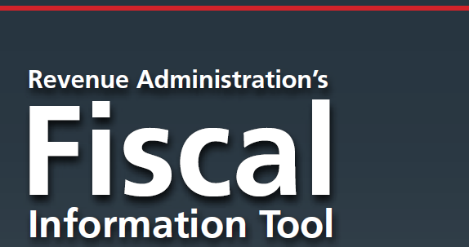
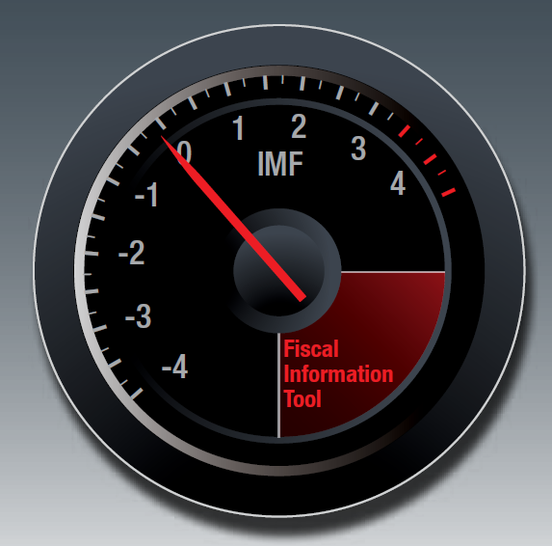
David Kloeden
June 2014

Slide 2
Presentation Overview
RA-FIT Project
RA-FIT Questionnaire
Preliminary Results of the 1st Iteration
Launching the 2nd Iteration
Lessons Learned

Slide 3
The RA-FIT Project

Slide 4
RA-FIT is an IMF initiative to:
Gather and analyze revenue administration data (quantitative and qualitative)
Establish baseline measures by appropriate grouping (e.g. regions/income level)
Raise the importance of revenue administration performance measurement
Make data/analysis available to member countries for improving cross-country comparisons and benchmarking (seek to provide data, not rank administrations)
Improve the quality and effectiveness of IMF’s Technical Assistance

Slide 5
The RA-FIT Project
Our goal: Help strengthen Tax and Customs Administrations’ management and operational performance.
Our principle: “If you can’t measure it, you can’t manage it.”
Yet, the first RA-FIT exercise (2012) shows that revenue administration performance measurement has a long way to go, especially in developing countries.

Slide 6
RA-FIT Questionnaire

Slide 7
Questionnaire Structure (1st Iteration)
A 62-question survey organized along the following themes:
Revenue Data
Tax and Customs Administrations’ Institutional Arrangements (type of entity, autonomy, office network, staffing, cost)
Tax Administration Operations (registration, filing, audit, arrears enforcement, dispute resolution)
Customs Administration Operations (selectivity channels and clearance times, post-clearance audits)
Targeted 120 countries (mainly developing countries supported by our Regional Technical Assistance Centers).

Slide 8
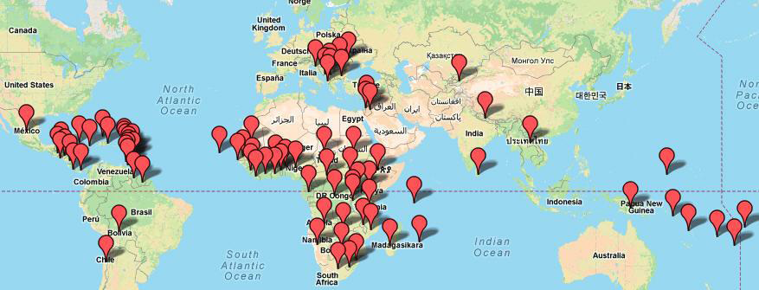
Survey Response Summary
Received returns from 85 of the 120 countries surveyed
(70 percent response rate)

Slide 9
Composition of Survey Respondents
60% of respondents are from LIC AND LMIC countries; 72% are from AFR and WHD (mainly Caribbean and Central America)

Slide 10
Preliminary Results of the 1st Iteration

Slide 11
Data Issues
Key issues to consider:
Responder bias
Not all countries responded to survey
Some countries unable to provide responses to all questions
Uncertainty regarding definitions of key concepts
Structural data issues
Diversity of respondents, will affect summary findings at “overall” level, vs. income or regional levels
Outliers in the response data

Slide 12
Revenue Data
Analysis combines RA-FIT and WEO data
Key issues to investigate:
What can we say about the relationship between revenue collection and development level?
Does revenue composition (tax type) differ across geographic regions/income grouping?
Are there any insights on how different taxes behaved over the past decade (and during the crisis) across regions?
How does the VAT behave across countries?

Slide 13
Tax Composition- 2012

Slide 14
RA-FIT VAT Composition- 2010

Slide 15
Institutional Arrangements
60 percent of the RA-FIT respondents have tax and customs administration conducted by directorates of MoFs; the balance have adopted more autonomous arrangements (semi-autonomous bodies with or without boards).
Unified semi-autonomous bodies are predominant in Anglophone Africa (85 percent of respondents) while less autonomous arrangements predominate in Asia, Middle East and the Caribbean.

Slide 16
Institutional Arrangements
Notes:
The percentages are divided by the whole sample (divided by 85)

Slide 17
Human Resources
66 respondents provided tax staffing information from the 83 countries completing tax operations

Slide 18
Cost of Collection-Tax Admin
 | Total Cost of Collection - 2010 | Operating Cost % - 2010 | Cap Ex Cost % - 2010
LOW INCOME COUNTRIES | 2.41% | 95% | 5%
LOWER MIDDLE INCOME COUNTRIES | 2.15% | 94% | 6%
UPPER MIDDLE INCOME COUNTRIES | 1.86% | 91% | 9%
HIGH INCOME COUNTRIES | 1.16% | 97% | 3%
OECD – CIS HIC SAMPLE (13) | 1.16% | 88% | 12%
68 respondents provided total annual expenditure information from the 83 countries completing tax operations

Slide 19
Cost of Collection- Customs Admin
 | Total Cost of Collection - 2010 | Operating Cost % - 2010 | Cap Ex Cost % - 2010
LOW INCOME COUNTRIES | 2.60% | 95% | 5%
LOWER MIDDLE INCOME COUNTRIES | 2.79% | 95% | 5%
UPPER MIDDLE INCOME COUNTRIES | 4.08% | 83% | 17%
HIGH INCOME COUNTRIES | 5.53% | 83% | 17%
48 respondents provided total annual expenditure information from the 63 countries completing customs operations

Slide 20
Large Taxpayer Office Metrics
 | % to Total Staff - 2010 | Taxpayers to Staff - 2010 | LTO Revenue as % of Total - 2010
LOW INCOME COUNTRIES | 5% | 7 | 45%
LOWER MIDDLE INCOME COUNTRIES | 6% | 13 | 50%
UPPER MIDDLE INCOME COUNTRIES | 4% | 13 | 50%
HIGH INCOME COUNTRIES | 2% | 40 | 31%
Sample Average | 5% | 13 | 47%
OECD – CIS HIC SAMPLE (13) – 2011 | 4% | 41 | NA
62 respondents indicated they had LTOs and 47 provided some information

Slide 21
On-time Filing Rates

Slide 22
Audit Mix

Slide 23
Audit Coverage as a % of Taxpayer Population
40 respondents provided audit coverage information

Slide 24
Audits assessments as a % of collections

Slide 25
Customs: Traffic by Channel

Slide 26
Customs: Traffic by Channel

Slide 27
Launching the 2nd Iteration

Slide 28
2nd Iteration
New developments for the 2nd round:
Adoption of a web-based platform (rather than an Excel workbook)
Partnerships with CIAT and WCO
New set of (refined) questions
Development of a dashboard
Web-based platform to be launched in 2014 Q1

Slide 29
Lessons Learned

Slide 30
Lessons Learned
Several data problems and challenges (missing data, inconsistencies, sample size)…but, yet, many interesting early conclusions (as we just saw).
Easy to write strategic plans on paper; much more difficult to apply effective strategic management daily…i.e. measure and follow performance systematically as part of a decision-taking mechanism.
Performance measurement is an area deserving more international attention and cooperation.

Slide 31
Thank you!

