Slide 1
Agriculture in the Post-2015 Sustainable Development Agenda
Achim Dobermann
SDSN, TG 7 – Sustainable Agriculture and Food Systems
Workshop on Food Security in the Post‐2015 Development Agenda, Paris, 29 January 2014

Slide 2
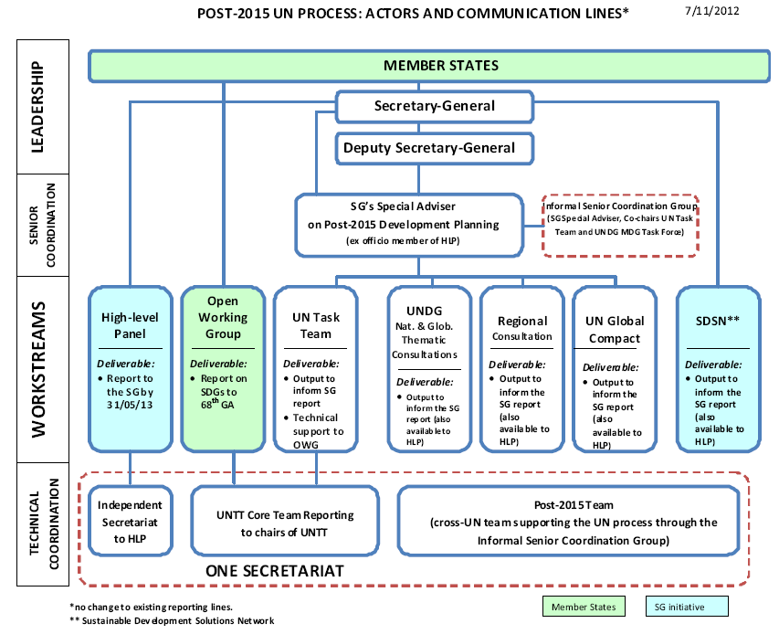

Slide 3
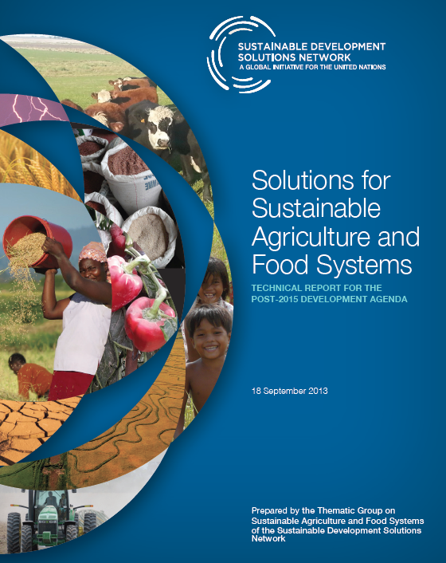
Website: www.unsdsn.org
Email: info@unsdsn.org

Slide 4
The pillars of the new sustainable development agenda
Economic development
Social inclusion
Environmental sustainability
Good governance

Slide 5
Our generation needs to make deep changes in technologies and policies to decouple future economic growth from unsustainable use of:
Fossil fuels
Land
Oceans
Freshwater
Other resources

Slide 6
The new food system challenge
Change behavior towards healthier diets and reduce food loss and waste
Increase productivity by more than 60% on existing crop and pasture land by 2050
Preserve the environment through lower resource intensity and sound use of inputs
Make farming an attractive economic opportunity for (young) people living in rural areas

Slide 7
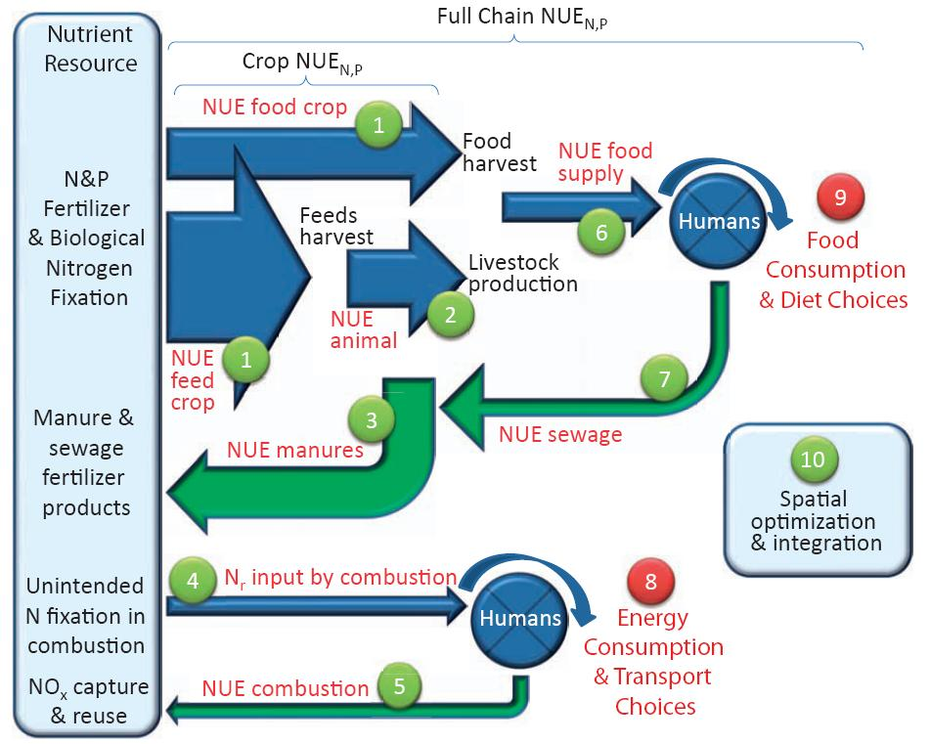
10 actions to increase nutrient use efficiency
Full Chain NUE_{N,P}
Source: Sutton, M.A. et al. 2012).

Slide 8
Different contexts → different targets → different solutions
Good market access
3
4
Low resource endowment
High resource endowment
2
1
Poor market access

Slide 9
SDSN proposal
10 SDGs
30 Targets
100 Core indicators
Additional indicators
http://unsdsn.org

Slide 10
10 SDGs proposed by the SDSN
End Extreme Poverty Including Hunger*
Achieve Development within Planetary Boundaries*
Ensure Effective Learning for All Children and Youth for Life and Livelihood
Achieve Gender Equality, Social Inclusion, and Human Rights for All
Achieve Health and Wellbeing at All Ages*
Improve Agricultural Systems and Raise Rural Prosperity*
Empower Inclusive, Productive and Resilient Cities
Curb Human-Induced Climate Change and Ensure Sustainable Energy*
Secure Ecosystem Services, Biodiversity and Good Management of Natural Resources*
Transform Governance for Sustainable Development*
* Goals that could include targets and indicators for agriculture
http://unsdsn.org

Slide 11
Goal 6: Improve Agriculture Systems and Raise Rural Prosperity
Targets:
6a. Ensure sustainable food production systems that achieve high yields with high efficiency of water, nutrients, and energy, and have low food losses and waste.
6b. Halt forest and wetland conversion to agriculture, protect soil resources, and ensure that farming systems are resilient to climatic change and disasters.
6c. Ensure universal access in rural areas to basic resources and infrastructure services (land, water, sanitation, modern energy, transport, mobile and broadband communication, agricultural inputs, and advisory services).

Slide 12
Target 6a: Sustainable food production systems
Core Indicators:
Crop yield gap (actual yield as % of yield potential)
Crop nitrogen use efficiency (%)
Crop water productivity (tons of harvested product per unit irrigation water)
Share of agricultural produce loss and food waste (% of food production)
Tier 2 Indicators, e.g.:
Cereal yield growth rate (% p.a.)
Indicator on livestock and fish productivity
Full-chain nitrogen [phosphorus] use efficiency (%)
……

Slide 13
Target 6a: Sustainable food production systems
Aspirational outcomes:
The majority of farms achieve [80]% of the attainable water-limited yield potential by 2030.
Nitrogen efficiency of crop production increased by [30]% in countries with sub-optimal [low] nitrogen use efficiency.
Water productivity of crop production increased by [30]% in countries with high water use for irrigation.
Post-harvest losses and food waste have been reduced by [30]% in 2030 relative to current levels.

Slide 14
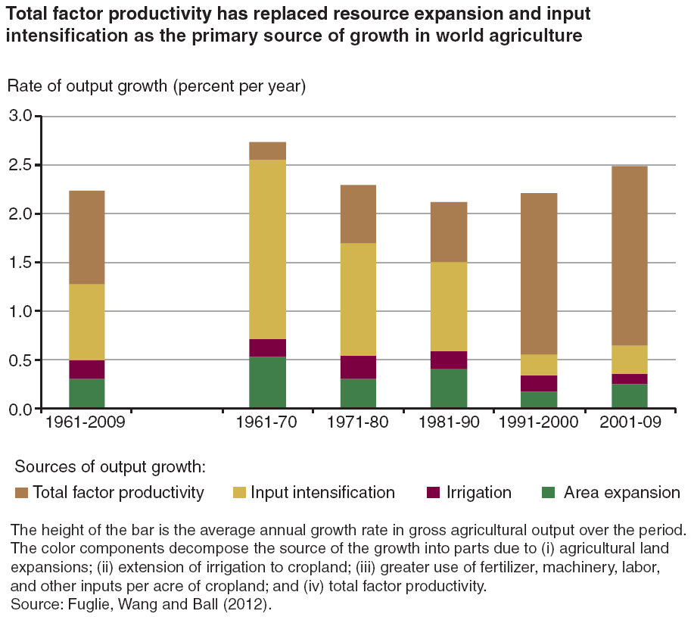
Total factor productivity is the primary source of growth in agriculture – but is highly variable among countries
S&T role
Source: K. Fuglie et al., 2012

Slide 15
More public and private investments in agricultural S&T
Increase funding for public agric. R&D in all countries.
Target 10b:
Low- and middle-income should spend at least 10% of natl. budget on agriculture, including at least 1% of agricultural GDP on R&D in their country (currently: ~0.5% or less)
ODA: spend at least 10% on agriculture
Create IP laws, other regulations, technology incentives that encourage greater private sector investments in S&T as well as wide access to innovations.

Slide 16
Major challenges
Context-specific targets, policy and technology roadmaps at national and sub-national levels
Monitoring the performance of agriculture and food systems at unprecedented levels
Increased public and private R&D while ensuring wide access to know-how and information
People

