Slide 1
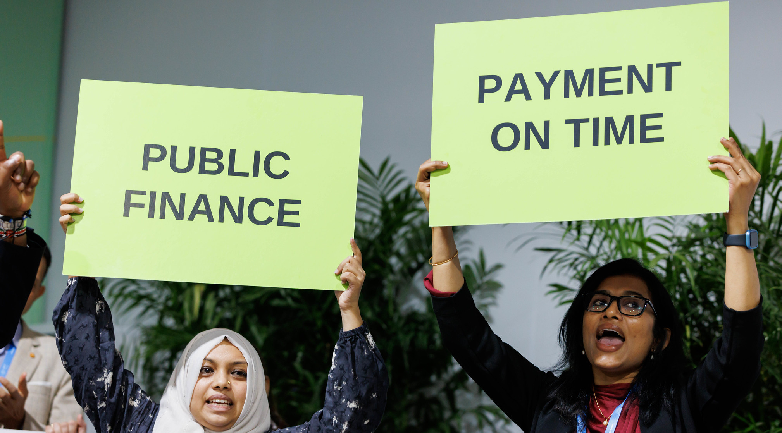

Climate Finance:
Who should provide &
who should receive?

Slide 2
Who should provide: Governments
Criteria could be based on:
Income levels
GHG emissions
Climate vulnerability
Other historical and current factors

Slide 3
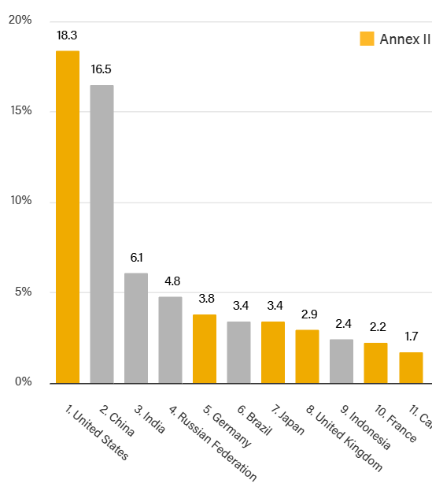
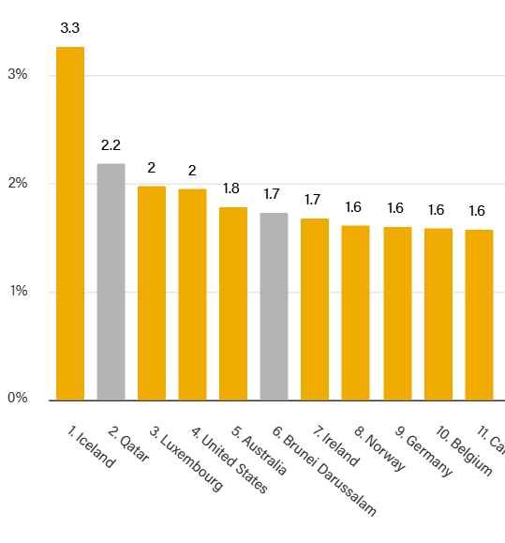

Emphasizing total
Emphasizing per capita

Slide 4
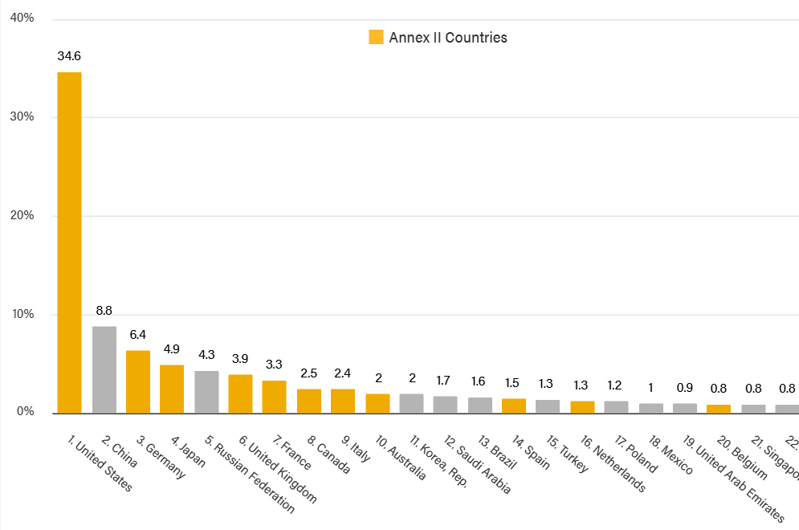
PARAMETERS
Weighting: income 75%, emissions 25%
Total emissions and total GNI PPP combined with per capita
Excludes most vulnerable countries

Slide 5


Who should provide: Private sector
Not part of the same system of commitments and accountability, but should arguably be responsible based on climate impact
To collect and distribute, could use efforts like:
Maritime shipping fee through IMO
Aviation fees
Fossil fuel windfall tax

Slide 6
Fairness in who should receive
Fairness in who receives
Level of development/income
Climate vulnerability
Emissions levels?

Slide 7



Thank You.
Contact us
wri.org
+1 (202) 729-7600
10 G Street NE, Suite 800 Washington DC 20002

