Slide 1
The IAMTAX: an overview

Slide 2
The elusive quest for measuring performance in the public sector
Delivering better results from revenue administration reform interventions requires explicit evidence to enable measuring these results in practice
Revenue administration reform is highly-context dependent
Political economy factors matter
Tax policy + revenue administration= the real policy
Developing performance indicators that try to measure the extent to which tax structures are efficient, equitable, effectively administered, and promote the social contract between citizens and the state.

Slide 3
Dealing with risks….
IAMTAX is a management tool that facilitates revenue administration managers to identify internal and external risks and to deal with them
The model measures current performance against a set of desirable standards and good practices and also allows countries to evaluate its performance over time
This tool places strong emphasis on a country’s context and its evolving nature by proposing a dynamic framework to better accommodate changes in the country’s environment
IAMTAX is a web-based tool that includes both an external evaluation function and a self assessment option
The model is built on benchmarking analysis, but it recognizes the fact that no one-size fits all.

Slide 4
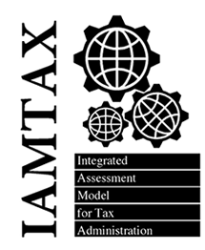
IAMTAX - Objectives
Identify performance gaps by comparing actual performance with benchmarks and international good practices in the area of taxation
Elaborate an action plan that prioritizes technical assistance activities aimed at addressing identified performance gaps
Undertake a diagnostic study of tax administration in order to establish a baseline that allows us to monitor tax administration performance over time (TTAP)

Slide 5
Inherent limitations of benchmarking….
Making benchmarking effective: risks and opportunities
Opportunities:
Better understand the strengths and limitations of existing systems and practices in order to guide reform efforts
Identify opportunities, priorities, and directions for reform
Judge reform programs
Need to adopt a systemic approach and have a broader understanding of the overall tax system environment
Risks:
Benchmarking and diagnostic exercises
can easily become focused on ranking
tax systems in order to facilitate
cross-country comparisons and simple
quantitative judgments about system
effectiveness
In practice it is frequently donors and
external actors who are most heavily
focused on international comparison while
local actors are primarily concerned with
targeted diagnostic exercises that can inform
reform priorities

Slide 6
IAMTAX reference system revolves around 14 strategic dimensions (….and 12 business areas)
Key features of developed tax administrations:
Fostering voluntary compliance
Process orientation (Business Intelligence)
The key role of ICTs
Progress made in international dimensions of taxation
Information as a key asset of tax administration
……..
A new paradigm for control of compliance based on cooperation
Customer orientation
Market segmentation together with risk analysis techniques as a central plank of a modern control of compliance strategy

Slide 7
The reference system is linked to the environment in which tax administration operates…..
Key Objectives Strategic Dimensions
Operational Level
Transparency, equity and simplification of tax legislation
Simplification of tax legislation;
Client/taxpayer orientation;
Enhancing voluntary compliance;
Extensive use of Information and Communication Technology;
Segmentation of taxpayers;
Compliance risk management approach to tax audit:
Information as a fundamental asset of the tax administration;
Emphasis on Human Resource Management;
Increasing relevance of international taxation;
Equity and transparency of tax system;
Process orientation;
Planning as a core element of tax administration;
Increasing the analytical capacities of tax administration
External communication policy, which fosters relations with the private sector and other stakeholders;
Outputs
No. of tax audits;
Tax disputes resolved;
Tax services provided;
Tax arrears collected;
Other
Outcomes
Change in compliance behavior;
Increased level of voluntary compliance;
Strategic Vision
Core Business Processes
Control
Mass Processes (Processing of tax returns, taxpayer services..)
Market segmentation (Tax audit function, revenue arrears management…)
Taxpayer registry
Taxpayer account
Effectiveness
e - Offices
Third party information
Banks
Efficiency
Inputs
Human resources; budget; and infrastructure (physical and IT)
Taxpayer services and external communication
Environment

Slide 8
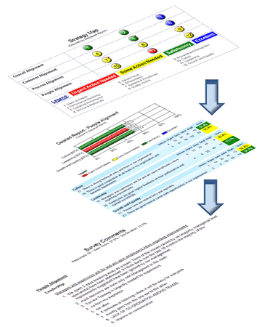
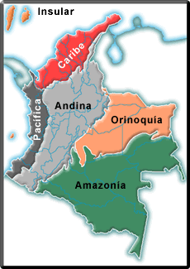
Measurement Framework Indicators
IAMTAX Indicators
Type of taxpayer
Performance indicators
(53)
Output indicators
(32)
Economic sector
Drill down indicators
Geographic Location/
Region

Slide 9
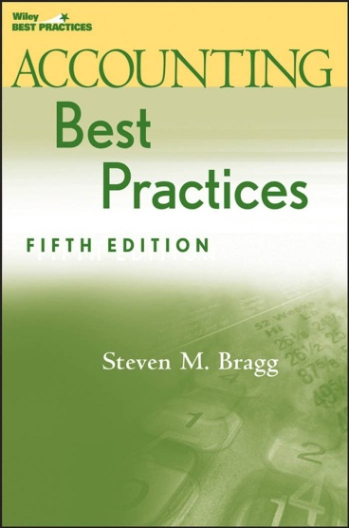
Good Practices in Tax Administration
The model incorporates a significant number of good practices (145) extracted from international examples (e.g. EU Fiscal Blueprints), tax literature and the extensive experience of the World Bank Group in tax administration reform projects.

Slide 10
Levels of analysis
Indicators and good practices are classified according to three levels of analysis:
Legal and regulatory framework: stability of tax laws, potential impact of tax policy design and procedural regulations on efficient tax administration operation.
Institutional set up and capacity building: degree of autonomy of tax administrations, organizational structure, allocation of responsibilities between HQ and territorial offices, human resources and budget management, strategic planning, ICTs, or internal audit.
Core business processes (operations): key outcomes and intermediate outputs of core business areas of a tax administration.

Slide 11
Levels of capacity of tax administrations
Strategic vision and legal framework – which includes inter alia strategic vision, strategic planning capacity, transparency and equity, and tax simplification.
Operational performance – which includes efficiency and effectiveness of tax administration operation, taxpayer services, external communication, control of compliance, etc. It measures operational capacity of key functions of tax administration.
A bi-dimensional graph places a given tax administration in four levels of institutional capacity as follows: low performance, average performance, good performance, and outstanding performance (gold standard)

Slide 12
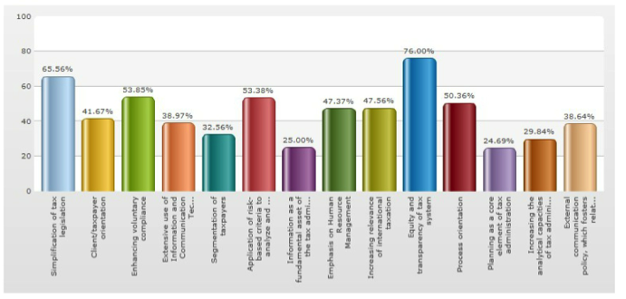
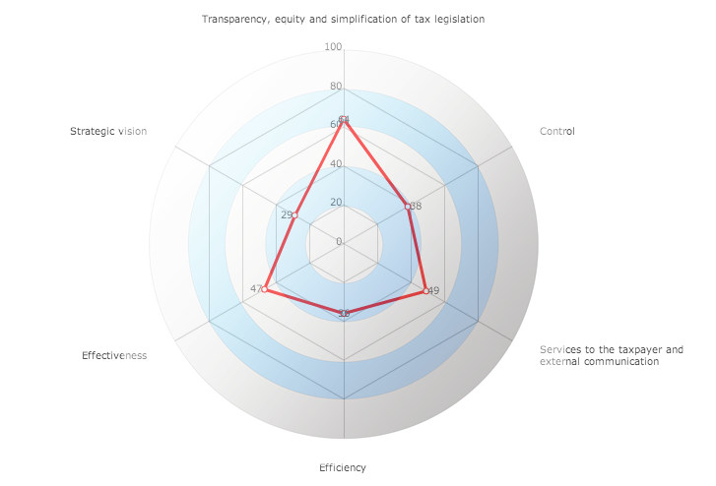
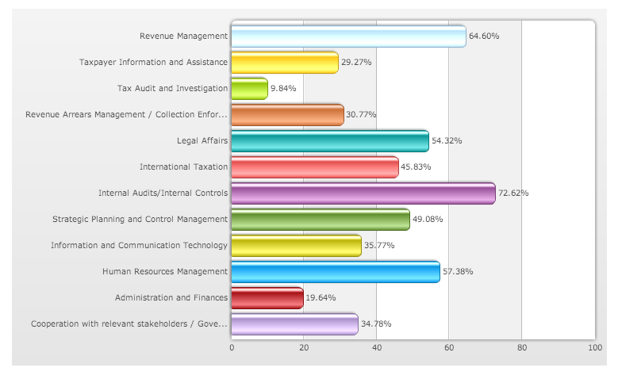
Interpreting and presenting results

Slide 13
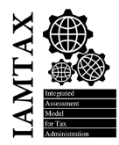
Moving towards enhancing the “quality” of tax systems and modernizing revenue administration
(Tax administration)
The Toolkit
(Customs)
TTAP
Political Economy of Tax Reforms
Subnational tax administrations (in prep.)
Small Municipalities
Business Taxation Module (BTM)
TTAP: Tracking Tax Administration Progress

Slide 14
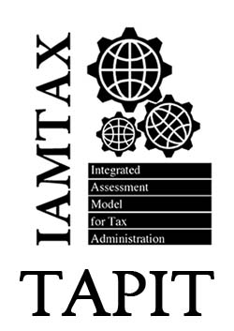
TRACKING TAX ADMINISTRATION PROGRESS (TTAP)
Tracks improvement goals for the Tax Administration
Monitor tax administration projects
Produces easy to use progress reports on measurable goals
IAMTAX External Assessment
IAMTAX Self Assessment
TTAP
Allows results-oriented planning based on actual objective measurements

Slide 15
Thanks for your attention
Questions?

