Slide 1
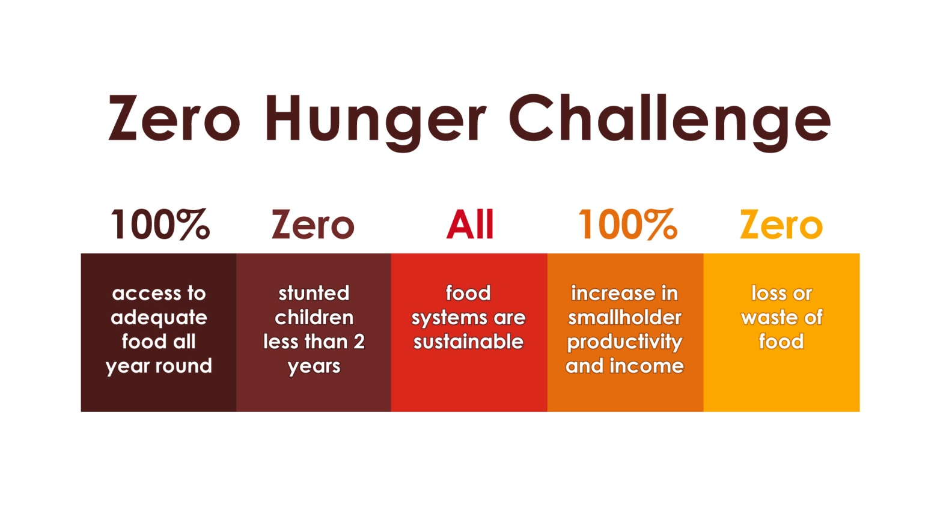
Food Security in the Post-2015 Development Agenda (1) A Potential Vision

Slide 2
Food Security in the Post-2015 Development Agenda (2)
Open Working Group develops Universal Goals for the World: Combining Economic, Environmental and Human Sustainability
JOINED-UP ISSUES: FRAMEWORK OF REFERENCE
Food & Nutrition Security: Availability, Access, Utilization, Stability
Food and Nutrition Security for All
Food and Nutrition Security for All through Sustainable … Agriculture and Food Systems
Food and Nutrition Security for All through Women-powering, Sustainable … Agriculture and Food Systems
Food and Nutrition Security for All through women-powering, Sustainable, Climate Compatible … Agriculture and Food Systems
Food and Nutrition Security for All through Women-powering, Sustainable, Climate Compatible … Agriculture, Food Systems and Food Consumption

Slide 3
Food Security in the Post-2015 Development Agenda (3)
Targets that take account of interests and needs of specific Nations and Populations: NB Employment …
Means of Implementation: Multi-stakeholder Partnerships with Clear Objectives, Operating Principles, Inclusive Membership and Dedicated Well-Used Finance.
Verification: Indicators, Data Systems, Analysis of Impact.
Governance and Accountability: Mutuality: Build on CFS.
Extremely complex systems which are challenging to Govern: The ideal is (a) common purpose, (b) single set of expected results; (c) synergy of action and (d) benefit.
Managing conflicts on what is success: varying criteria for accountability: building trust, countries at centre ….

Slide 4
Food Security in the Post-2015 Development Agenda
Fit-for-Purpose Governance
People-responsive [esp poor people]
Comprehensive Framework
Metric-driven
Country-Led
Territoires / PeopleScapes
Sectors Joined-Up and not Silos
Multi-stakeholder engagement
Safe space: conflict is managed
Regional Bodies
Role of UN System role: Catalyze, Facilitate, Convene

