Slide 1
Setting a Goal for Food and Nutrition Security through Sustainable Agriculture and Food Systems
Dr. Birgit Kopainsky, System Dynamics Group, University of Bergen, Norway
Workshop: Food Security in the Post-2015 Development Agenda
January 29, 2014; Paris

Slide 2
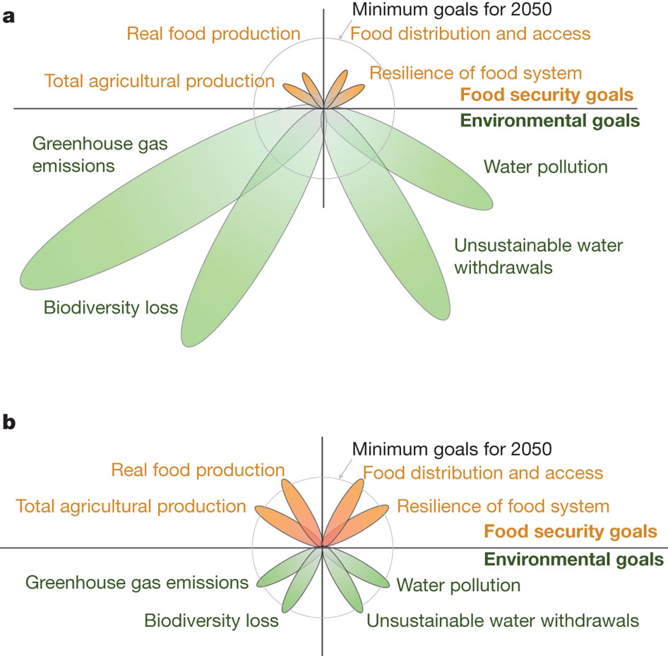
Foley, J. A., Ramankutty, N., Brauman, K. A., Cassidy, E. S., Gerber, J. S., Johnston, M., . . . Zaks, D. P. M. (2011). Solutions for a cultivated planet. Nature, 478(7369), 337-342

Slide 3
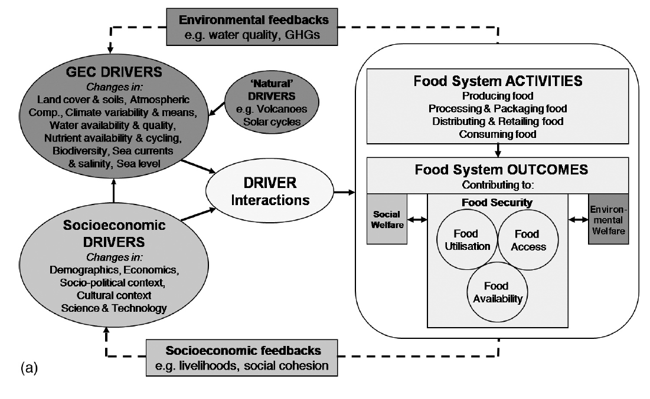
Ingram, J. S. I., Ericksen, P. J., & Liverman, D. (Eds.). (2010). Food Security and Global Environmental Change. London & Washington DC: Earthscan.

Slide 4
Post-2015 goal: Achieve food and nutrition security through sustainable agri-food systems
Targets & indicators

Slide 5
Targets

Slide 6
Food system ACTIVITIES
Global environmental change DRIVERS
Producing food
Processing & packaging food
Distributing & retailing food
Consuming food
Food system OUTCOMES contributing to:
Socioeconomic DRIVERS
Social welfare
Food security, i.e. stability over time for:
Environmental welfare
FOOD UTILIZATION
FOOD ACCESS
FOOD AVAILABILITY

Slide 7
Target 2.1
Implement and diffuse agri-food systems that conserve natural resources and ecosystems while being productive and resilient
Food system ACTIVITIES
Global environmental change DRIVERS
Producing food
Processing & packaging food
Distributing & retailing food
Consuming food
Target 3.3
Research and technology transfer support the transformation to sustainable food system activities
Target 2.2
Minimize food losses and waste
Food system OUTCOMES contributing to:
Target 3.2
Establish inclusive, transparent and equitable decision-making processes on food, nutrition and agriculture
Target 1.3
Improve the livelihood of rural communities
Socioeconomic DRIVERS
Social welfare
Food security, i.e. stability over time for:
Environmental welfare
Target 1.2
Align food systems with environmental welfare
Target 1.1
End malnutrition and hunger in each of their forms
FOOD UTILIZATION
Target 3.1
Ensure equitable multilateral trade systems and mitigate excessive food price volatility
FOOD ACCESS
FOOD AVAILABILITY

Slide 8
Target 2.1
Implement and diffuse agri-food systems that conserve natural resources and ecosystems while being productive and resilient
Food system ACTIVITIES
Global environmental change DRIVERS
Producing food
Processing & packaging food
Distributing & retailing food
Consuming food
Food system OUTCOMES contributing to:
Socioeconomic DRIVERS
Social welfare
Food security, i.e. stability over time for:
Environmental welfare
Target 1.1
End malnutrition and hunger in each of their forms
FOOD UTILIZATION
FOOD ACCESS
FOOD AVAILABILITY

Slide 9
Indicators

Slide 10
Target 2.1
Implement and diffuse agri-food systems that conserve natural resources and ecosystems while being productive and resilient
Food system ACTIVITIES
Global environmental change DRIVERS
Producing food
Processing & packaging food
Distributing & retailing food
Consuming food
Food system OUTCOMES contributing to:
Socioeconomic DRIVERS
Social welfare
Food security, i.e. stability over time for:
Environmental welfare
FOOD UTILIZATION
FOOD ACCESS
FOOD AVAILABILITY

Slide 11
Target 2.1
Implement and diffuse agri-food systems that conserve natural resources and ecosystems while being productive and resilient
Producing food
Processing & packaging food
Distributing & retailing food
Consuming food
e.g. land, soil fertility, water, nutrients in top soil, biodiversity
Resource
Inflow
Outflow
productivity/efficiency
production

Slide 12
Target 2.1
Implement and diffuse agri-food systems that conserve natural resources and ecosystems while being productive and resilient
Producing food
Processing & packaging food
Distributing & retailing food
Consuming food
% land under resource conserving low external input farming
Partly existing; includes resilience
Global level vs. national level
Carbon &/ water footprint of consumption
Existing
Global level vs. national level
Resource
Inflow
Outflow
Total factor productivity
Existing; possibly to be adapted
Mainly national level
productivity/efficiency
production

Slide 13
conclusions

Slide 14
Target and indicator framework
Multidimensional nature of sustainable agriculture and food and nutrition security
Especially for food system outcomes
Less so for food system activities & food system drivers

Slide 15
Target and indicator framework
Generic framework and targets
Common indicators → comparability
Differentiation → f(accountability)
Global level
National level
…

Slide 16
Outlook
Generic framework and targets
Common indicators → comparability
Differentiation → f(accountability)
Global level
National level
(☑)
(☑)
(☑)
☐

Slide 17
Outlook
Generic framework and targets
Common indicators → comparability
Differentiation → f(accountability)
Global level
National level
(☑)
(☑)
(☑)
☐

Slide 18
Thank you
birgit.kopainsky@geog.uib.no

