Slide 1
Measuring Accountability in Customs Services in Emerging Economies – An Indian Perspective B. K. Khare & Co. – Chartered Accountants
Dr. Shrikant Kamat
Senior Director & Practice Leader – Indirect Taxation

Slide 2
Accountability in Public/Government Organizations
Accountability in
Public Management
Effectiveness
Efficiency
Integrity
In a highly accountable public organization one can expect very low levels of corruption

Slide 3
Measuring Accountability vis-a-vis Performance
Performance Measurement | Accountability Measurement
Focus is on efficiency and cost reduction | Focus is on integrity, transparency of intent as well as delivery.
Growth in tax revenues is an important measure. | Ease of doing transactions and trade perception of this ease is the most relevant measure.
Used for driving strategy for deployment of human and material resources. | Used for creation of an environment conducive for faster and transparent trade transactions
Has clear limitations in evaluating mindset of people holding office of authority | Accountability being multi dimensional, the models/tools used for its measurement will be able to measure integrity, efficiency, effectiveness and transparency
Easier to define controls and design measurement tools as result are easily are easily quantifiable. | Defining controls and designing tools/techniques is complex given the continuous evolution of complex trade frauds and offences.

Slide 4
Available guidance for Customs PM
Revised Kyoto convention
WB Logistic Performance Index (LPI)
WCO Time Release Study (TRS) Version 2.0
WCO Safe framework of Standards
Paris Declaration
GATT 1994
WTO Trade Fadlitation Agreement, 2013

Slide 5
Customs Accounting in Emerging Economies
Emerging Economies – Countries considered to be in transition between developing and developed economic state
Emerging Economics are characterized by –
Fast growing GDP (from 4 %to 7%)
Investment forms a large share of GDP
Young and skilled work force
Generally perceived as laggards on transparency, cost & ease of doing business
List of leading emerging economies of the world (June 2014)
Emerging Economy | Ease of doing business ranking | Projected GDP Growth for 2014 - 15 | Average Total Investment as percentage share of GDP
China | 96 | 7.35 | 48.54
Malaysia | 6 | 5.00 | 27.66
Thailand | 18 | 4.50 | 31.48
Korea | 7 | 3.53 | 27.14
Philippines | 108 | 6.13 | 19.17
India | 134 | 5.15 | 35.15

Slide 6
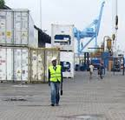
Customs Accountability in Emerging Economies
Given the high growth in consumption with corresponding growth in cross border ( import/export) transaction in goods in emerging economies, Customs services in these countries have the following additional responsibilities -
Facilitate trade
Counter terrorism/ensure higher security
Safeguard environment
Protect intellectual property
Demonstrate more transparency and integrity

Slide 7
India – An Emerging Economy with Challenges
Average GDP growth is 5 - 6 percent – rapidly growing
Population over 1.2 Billion - large consumption
Over 500 million below 40 years – young workforce
More than half of the young workforce is skilled or undergoing vocational training
India’s share in world trade - 19th largest exporter and 10th largest importer
India’s ranking in Ease of doing business – 134
Customs dwell time – 12 to 13 days
Corruption and speed money - a way of life and accepted culture for getting work done and clearing documents

Slide 8
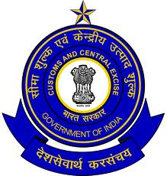
Indian Customs – Present days objectives
The Central Board of Excise & Customs (CBEC) is the governing body for customs administration in India
Three criteria constituting the three categories of objectives possible are used to assess program performance:
Socioeconomic objectives - by maintaining safety and security of the goods and people crossing India’s borders
Quality-of-service objectives - facilitating legitimate trade
Integrity objectives - by meeting expectations of the people and trade on Customs adherence to the rule of law
The Citizen’s Charter of the Department envisions that the Customs & Central Excise officers shall carry out their assigned tasks with integrity and judiciousness; courtesy and understanding; objectivity and transparency; promptness and efficiency. The officers are also committed to providing every possible assistance to the public and trade in implementation of the Customs policies and procedures.

Slide 9
Indian Customs – Present days objectives
Indian customs administration is seen to be having the following six performance indicators, namely:
establishing durable working partnership with Agencies involved in cargo clearance.
evolving minimum standards through mutual consultations with various Agencies to reduce delays in the release of Import/Export Cargo
co-operating with custodians at airports in setting up separate facilities for clearance of express consignments imported/exported through the courier mode.
co-operating with State Governments and other concerned agencies in developing and improving the infrastructure facilities for clearance of cargo at Inland Container Depots.
evolving a uniform nomenclature based on the harmonized system for levy of Customs and Excise duties, export and import trade policy and trade statistics.
instituting and operating formal consultative mechanism with the Director General of Foreign Trade/Ministry of Commerce for introducing or making changes in export and import trade policies.

Slide 10
Indian Customs – Recent Reforms
Following are a few of the many new initiatives undertaken by Customs:
Indigeneously designed software ICEGATE introduced (2002)
Risk Management based assessment (2005)
AEO program introduced (2012)
Self assessment and Post clearance audit introduced (2011)
24 x 7 Customs clearance at all major ports introduced (2012)
E- payment of Customs made mandatory (2012)
Scope of Advance Ruling Mechanism enlarged to cover more classes of importers/exporters (2013)

Slide 11
Indian Customs – Performance Parameters
Detention of cargo if queries on following aren't satisfactorily replied:
Valuation
Classification
Certification from relevant authorities such as food certification, pollution board
High risk cargo
IPR infringement
Training imparted on new initiatives and reform programs
Allegiance to citizens charter commitment renewed periodically
Confiscation and Seizure of detained cargo and issuance of Show Cause Notice if higher duty, fine & penalty not paid

Slide 12
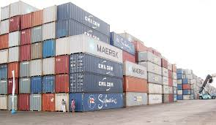
Common Grievances of Trade on Customs Performance
Number of cases where queries raised on routine shipments and resultant delay are on the increase
Field formations (officers stationed at ports) are not aware of decisions and orders of higher judiciary or the tribunals which are binding on them and continue to dispute on positions and issues that are already settled, thereby increasing the numbers of avoidable disputes and litigation.
Inspite of the new reform initiatives and projects introduced by customs, the transaction cost and dwell time has not reduced significantly and no perceptible change in Customs environment.

Slide 13
Key problems faced in customs by Trade
Source: Chaturvedi, S 2006, P. 29

Slide 14
Addressing the integrity perception in Customs
None of the surveys/studies undertaken till date touch upon or comment on the extent of corrupt practices in the Customs administration and correlate the cost and time increase on this account
Majority of business class surveyed have experienced corrupt practices in Customs clearance
Practice of offering speed money for clearance of routine shipments does not get reported
CBEC has constituted the following groups to address all grievances and complaints of the trade community –
Watchdog Committee
Regional Advisory Committee
Public Grievance Committee
Permanent Trade facilitation Committee
Airport Facilitation Committee

Slide 15
Way Forward on Accountability
Present performance measurement parameters have limited utility as customs commissioners do not have real time knowledge of delay in cargo or avoidable disputes
Accountability measures to be introduced in customs have to be in conjunction with external environment for doing business.
Present need is to introduce measuring parameters for projecting customs as transparent, free of bribery and corruption and trade friendly.
Focus of all Parameters should be on accurate measurement of accountability

Slide 16
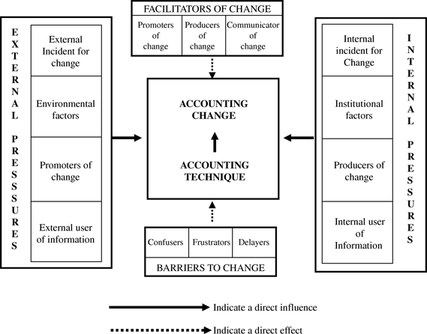
Way Forward on Accountability
New philosophies on public management should be embraced by Customs
Contingency model approach suitable for examining customs accountability on the basis of:
Stimuli
Structural variables
Characteristics of the political administrative system and
Implementation barriers

Slide 17
THANK YOU
B.K. Khare & Co.
Chartered Accountants
706-708, Sharda Chambers, Behind Aaikar Bhavan, New Marine Lines, Mumbai – 400020
Tel: (022) 22000607/7318/6360/6631 e-mail: shrikantkamat@bkkhareco.

