Slide 1
OECD Trade Facilitation Indicators: structure, state of implementation and potential impact on developing countries’ trade
Measuring the performance of tax and customs administrations in emerging and developing countries
Clermont-Ferrand, 12-13 June 2014

Slide 2
Overview
1. OECD TFIs: objectives, structure and state of implementation
2. Measuring potential impacts of TF
3. Policy implications

Slide 3
1. OECD TFIs: objectives, structure and state of implementation

Slide 4
OECD Trade Facilitation Indicators
What is the Impact of TF Measures on Trade Flows and Trade Costs ?
Following the structure of the Draft Consolidated Negotiating Text on Trade Facilitation (…since December 2013, the Trade Facilitation Agreement)
Aiming to provide a basis for prioritising trade facilitation actions by governments
Helping mobilise technical assistance by donors in a targeted way

Slide 5
TFIs structure: Import/Export
A. Information availability
Establishment of a Customs website
Publication of rate of duties
Establishment of enquiry points
Information on import and export procedures
Documents and forms available online
Procedures published at least xx days before entry into force
Publication of Agreements
Publication of decisions and examples of customs classification

Slide 6
TFIs structure: Import/Export
A. Information availability
B. Involvement of trade community
Communication of policy objectives
Consultations
Open consultations
Adoption of public comments

Slide 7
TFIs structure: Import/Export
A. Information availability
B. Involvement of trade community
C. Advance rulings
Issuance of advance rulings (AR)
Available information on AR
Publication of average issuance time
Publication of AR
Possibility to request review
Motivated refusal to issue or revocation

Slide 8
TFIs structure: Import/Export
A. Information availability
B. Involvement of trade community
C. Advance rulings
D. Appeal procedures
Publication of information on appeal procedures
Judicial appeal procedures
Time limit for deciding appeals
Information on the motives of decision

Slide 9
TFIs structure: Import/Export
A. Information availability
B. Involvement of trade community
C. Advance rulings
D. Appeal procedures
E. Fees and charges
Publication of fees and charges
Evaluation of fees and charges
Total fees and charges collected
Fees for Customs services during normal working hours

Slide 10
TFIs structure: Import/Export
A. Information availability
B. Involvement of trade community
C. Advance rulings
D. Appeal procedures
E. Fees and charges
F. Formalities - Documents
Use of copies
International Standards compliance
Number of documents
Necessary time to prepare documents

Slide 11
TFIs structure: Import/Export
A. Information availability
B. Involvement of trade community
C. Advance rulings
D. Appeal procedures
E. Fees and charges
F. Formalities - Documents
G. Formalities - Automation
Use of risk management
IT systems capable of accepting Electronic Data Interchange
Availability of full-time automated processing for Customs agencies
Quality of telecommunications and IT

Slide 12
TFIs structure: Import/Export
A. Information availability
B. Involvement of trade community
C. Advance rulings
D. Appeal procedures
E. Fees and charges
F. Formalities - Documents
G. Formalities - Automation
Pre-arrival processing
Pre-shipment inspection
Adjustment of working hours to commercial needs
Requirement for clearance by a Customs broker
Single Window
H. Formalities - Procedures

Slide 13
TFIs structure: Import/Export
A. Information availability
B. Involvement of trade community
C. Advance rulings
D. Appeal procedures
E. Fees and charges
F. Formalities - Documents
G. Formalities - Automation
H. Formalities - Procedures
I. Border Cooperation - Internal
J. Border Cooperation - External

Slide 14
TFIs structure: Import/Export
A. Information availability
B. Involvement of trade community
C. Advance rulings
D. Appeal procedures
E. Fees and charges
F. Formalities - Documents
G. Formalities - Automation
H. Formalities - Procedures
I. Border Cooperation - Internal
J. Border Cooperation - External
K. Consularization

Slide 15
TFIs structure: Import/Export
A. Information availability
B. Involvement of trade community
C. Advance rulings
D. Appeal procedures
E. Fees and charges
F. Formalities - Documents
G. Formalities - Automation
H. Formalities - Procedures
Transparent Customs structure and functions
Code of conduct
Ethics policy
Internal audit system
Annual Customs Report
I. Border Cooperation - Internal
J. Border Cooperation - External
K. Consularization
L. Governance and impartiality

Slide 16
TFIs structure: Transit
M. Transit fees and charges
Information availability
Prior publication
Periodic review and adaptation
Evaluation of transit fees and charges

Slide 17
TFIs structure: Transit
M. Transit fees and charges
N. Transit formalities
Information availability
Periodic review and adaptation
Physically separate border-crossing facilities/infrastructure for transit
Limited physical inspections of goods and use of risk assessment
Quality controls or technical standards applied

Slide 18
TFIs structure: Transit
M. Transit fees and charges
N. Transit formalities
Multiple forms of guarantees accepted
Guarantees supported by regional or international agreements
Prompt and full release of guarantees
Use of Customs convoys
O. Transit guarantees

Slide 19
TFIs structure: Transit
M. Transit fees and charges
N. Transit formalities
O. Transit guarantees
Bilateral or regional agreements
Transit cooperation – formalities; legal requirements; practical operation
P. Transit agreements and cooperation

Slide 20
Data collection process
Extensive data collection process:
Customs websites
national regulations
publicly available databases
regional organizations reports
collaboration with countries’ Permanent Delegations to the WTO
collaboration with UN ESCAP on information for transit measures

Slide 21
Extensive coverage
Import/Export TFIs available for 133 countries at different stages of development
Transit measures data collected so far for 27 African and Asian landlocked and transit countries
Focus on country groups: income groups, geographic groups, regional economic partnerships groups

Slide 22
TFIs: state of implementation
The OECD trade facilitation indicators are a tool that allows exploring the importance of trade facilitation performance across different:
income groups
regions
countries

Slide 23
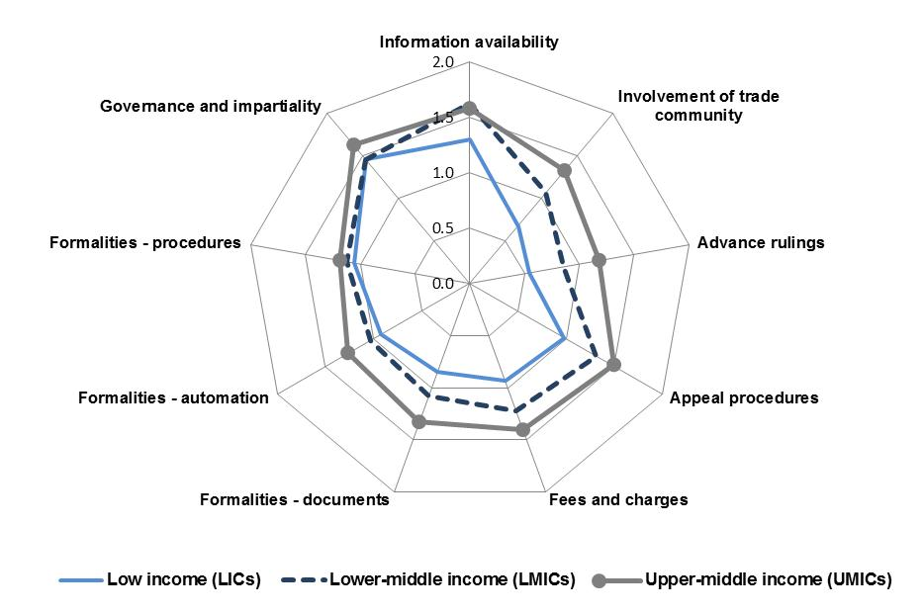
TFIs state of implementation: Income groups
0 = worst performance → 2 = best performance
Notes:
The figure provides an overall picture of the performance differences across the various income groups in the state of implementation for the compiled sets of measures. This overview confirms that there are differences prevailing between the income groups of countries. It also allows observing in which areas the gaps are larger to fill. There appear to be more significant disparities related to income level in the areas of consultations, advance rulings, appeal procedures or harmonisation and simplification of documents than in the areas of automation or procedures simplification.
Data collected up to January 2013

Slide 24
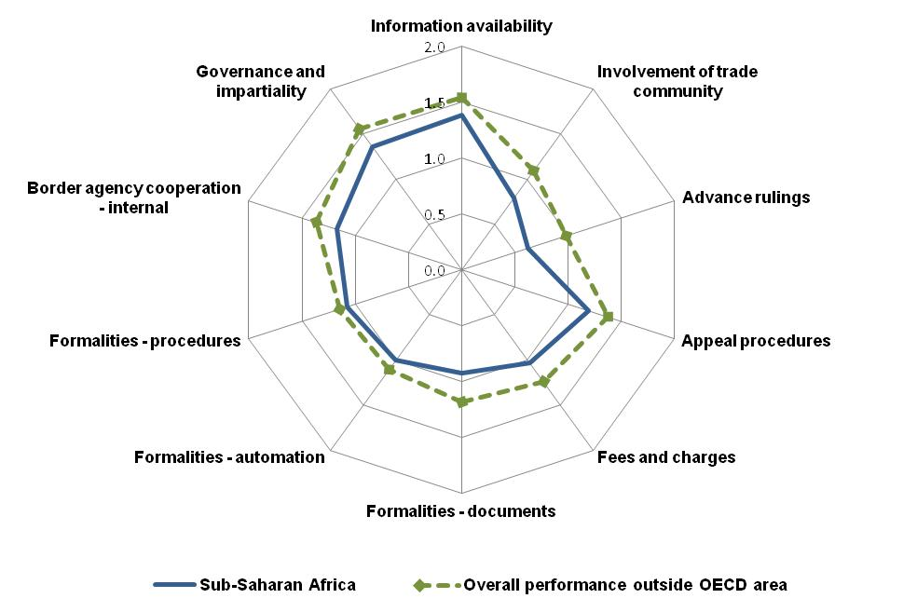
Sub-Saharan Africa

Slide 25
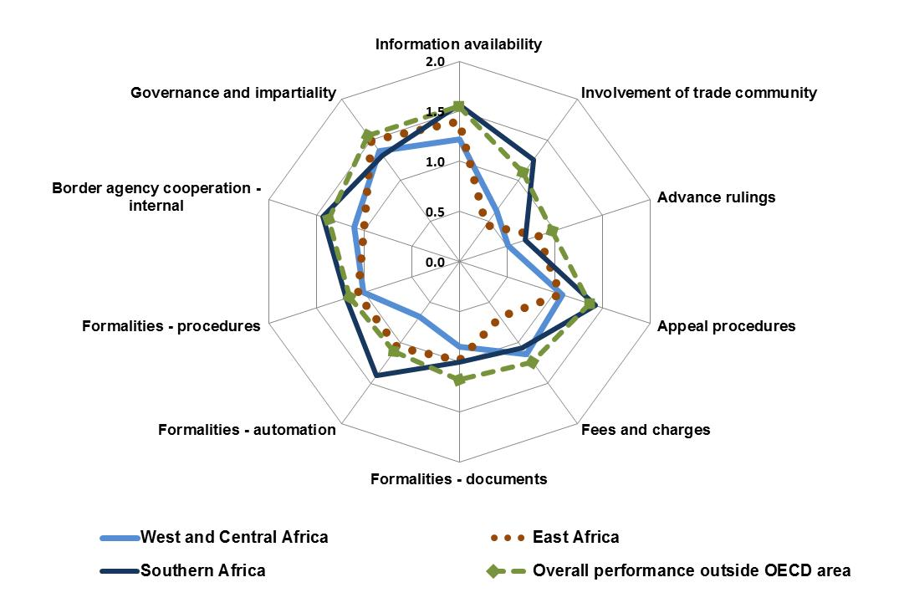
…and main sub-regions in Sub-Saharan Africa

Slide 26
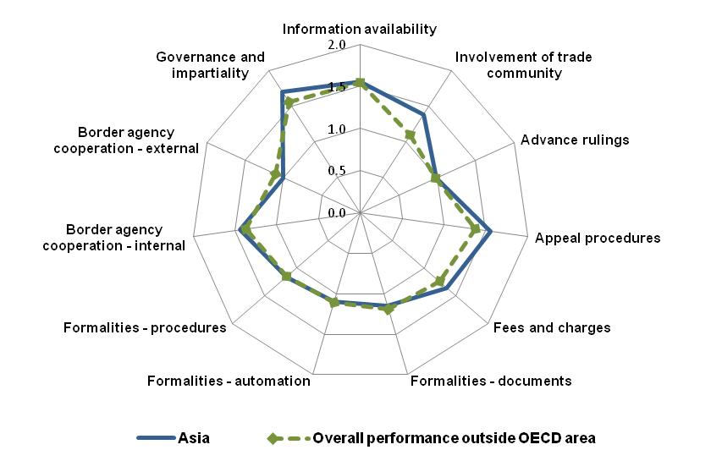
Asia
Notes:
Example of other regions

Slide 27
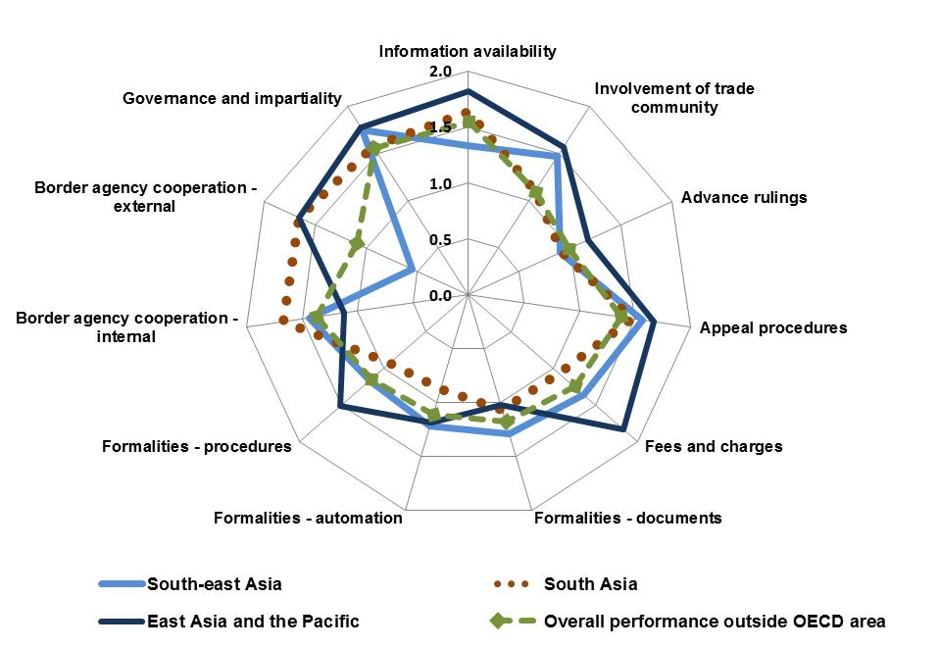
…and main sub-regions in Asia

Slide 28
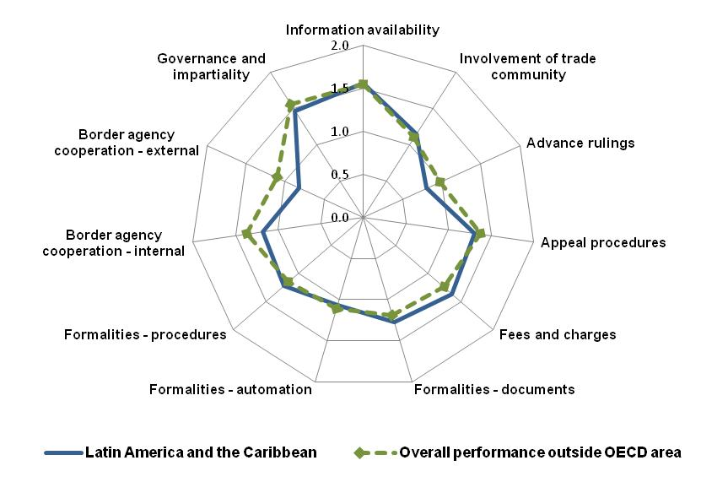
Latin America and the Caribbean

Slide 29
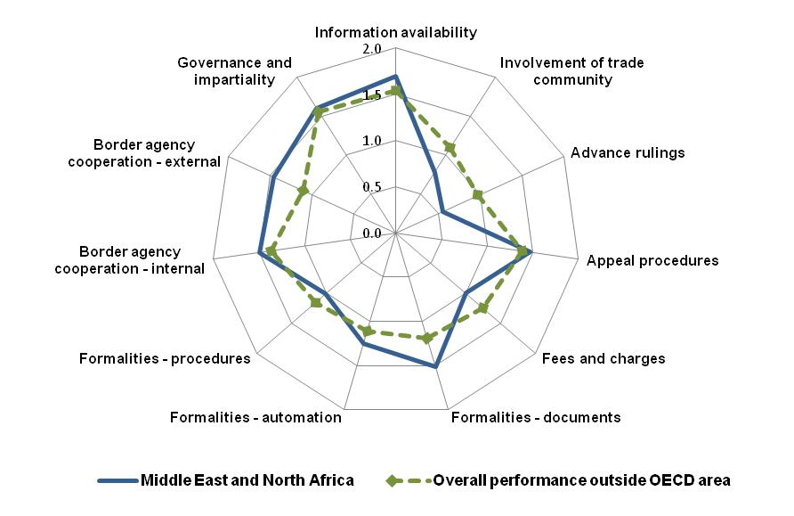
Middle East and North Africa

Slide 30
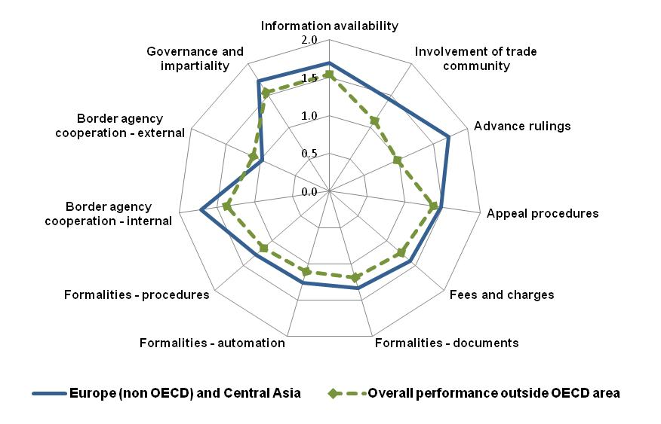
Europe (outside the OECD area) and Central Asia

Slide 31
2. Measuring potential impacts of TF

Slide 32
Potential impacts on trade flows
Result most important for:
- increasing trade flows with the rest of the world
- boosting intra-regional trade
- equally important for both exports and imports
Information availability
Simplification and harmonisation of Documents
Automating processes
Streamlining of Procedures
Governance
Notes:
Econometric analysis

Slide 33
Potential impacts on trade costs
Comprehensive trade facilitation reform is more effective than isolated or piecemeal measures
the potential trade cost reduction of all the trade facilitation measures is within intervals of 10% to 16%, across income and geographic country groups
Harmonising and simplifying trade documents, streamlining border procedures, automating trade and customs processes, and ensuring the availability of trade-related information
among the sets of measures with the strongest potential in reducing trade costs across the different groups of countries
Potential impact on trade costs of implementing the TFA
“limited implementation” scenario (only mandatory provisions)
“full implementation” scenario (taking into account “best endeavor” provisions)

Slide 34
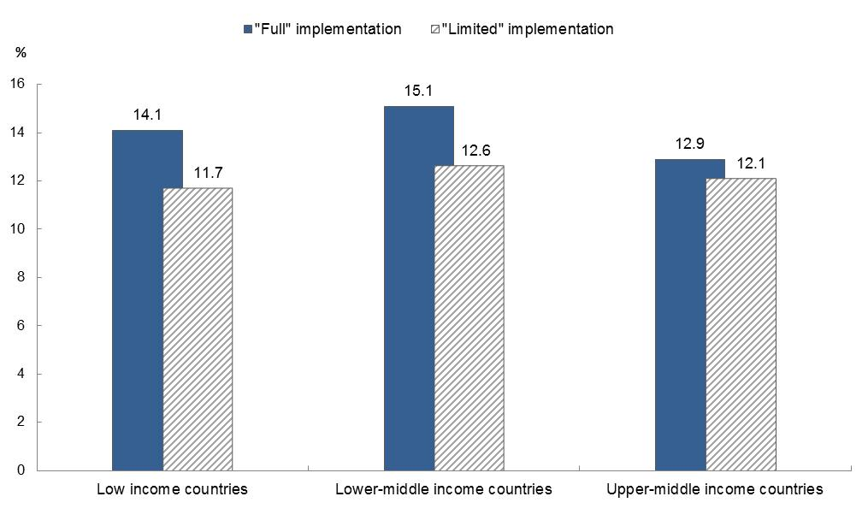
Potential trade cost reduction of implementing the TFA

Slide 35
Transit indicators – potential impacts
Results highlight Transit formalities and Agreements and cooperation as important for landlocked developing countries’ trade
Transit guarantees result important for landlocked countries’ exports

Slide 36
3. Policy implications

Slide 37
Policy implications
The use of the indicators in this proposed framework should enable countries sharing similar characteristics to better assess which trade facilitation dimensions deserve priority
This empirical evidence provides useful information to guide policymakers, private sector practitioners and other stakeholders on which might be the areas for which resource allocation could bring the highest benefits
The set of variables identified shows that some measures for which costs are considerably lower than for larger infrastructure projects can bring high benefits (e.g. the simplification and harmonisation of documents, increasing information availability)

Slide 38
Trade Facilitation Costs and Challenges
OECD country survey assessing TF reforms
→ 2005 – 15 developing countries and 2013 – 9 developing countries
regulatory changes
institutional changes
equipment and infrastructure
training
diagnostic and re-engineering costs
awareness-raising and change management
OECD Trade Facilitation Indicators analysis
costs
complexity
challenges
impacts
benefits
transparency and predictability measures
procedural simplification and streamlining
coordination and cooperation between border agencies
Holistic approach but implementation tools carefully combined and sequenced

Slide 39
Thank you for your attention!
OECD Trade Facilitation Indicators
http://www.oecd.org/tad/facilitation/indicators.htm

