Slide 1
A survey on Customs performance measures in the Caribbean
Mr. Andrea Bolognesi, Mr. Fabian Joseph, Mr. Bertrand Laporte, Mr. Jaime Mendoza
12-13 June 2014, Clermont Ferrand
Presented by
Andrea Bolognesi

Slide 2
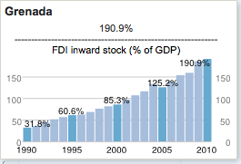
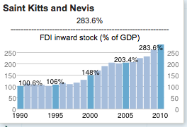
Economic profiles of Caribbean countries
The economies of the Caribbean shares some characteristics and threats that are usually associated with small economies.
In 2011, the total trade in goods and services represented over 60% of GDP in all Caribbean states.
Notes:
Trade-dependent economies like the ones of the Caribbean region increasingly depend on trade facilitation efforts in order to successfully integrate into the world economy. These facilitation efforts, in turn, rely heavily on reforms at Customs and greater efficiencies in port logistics. As a result, Customs administrations have become an object of study and a number of different approaches and methodologies have emerged over the years for assessing the effectiveness and efficiency of Customs .
In this regard, various institutions have developed indicators that are used to establish a relative ranking of performances based on quantitative and/or qualitative analysis.
The economies of the Caribbean shares some characteristics and threats that are usually associated with small economies. These commonalities can be categorized as trade openness, economic vulnerability (Barker 2012; Jahan at al. 2013), natural resources and capacity constraints, high exposure to natural disasters (Rasmussen 2006) and susceptibility to environmental shocks and external changes. Notwithstanding this, Caribbean states may vary in terms of the structure of their economy which can be divided into three main groups, namely: commodity exporters, service-based economies (mainly tourism and financial services) and microstates (IMF 2013).

Slide 3
Performance indicators results
OECD Trade Facilitation Indicators
World Bank’s “Doing Business” Report
The Customs Assessment Trade Toolkit (CATT)
Notes:
Trade-dependent economies like the ones of the Caribbean region increasingly depend on trade facilitation efforts in order to successfully integrate into the world economy. These facilitation efforts, in turn, rely heavily on reforms at Customs and greater efficiencies in port logistics. As a result, Customs administrations have become an object of study and a number of different approaches and methodologies have emerged over the years for assessing the effectiveness and efficiency of Customs .
In this regard, various institutions have developed indicators that are used to establish a relative ranking of performances based on quantitative and/or qualitative analysis.
The economies of the Caribbean shares some characteristics and threats that are usually associated with small economies. These commonalities can be categorized as trade openness, economic vulnerability (Barker 2012; Jahan at al. 2013), natural resources and capacity constraints, high exposure to natural disasters (Rasmussen 2006) and susceptibility to environmental shocks and external changes. Notwithstanding this, Caribbean states may vary in terms of the structure of their economy which can be divided into three main groups, namely: commodity exporters, service-based economies (mainly tourism and financial services) and microstates (IMF 2013).

Slide 4
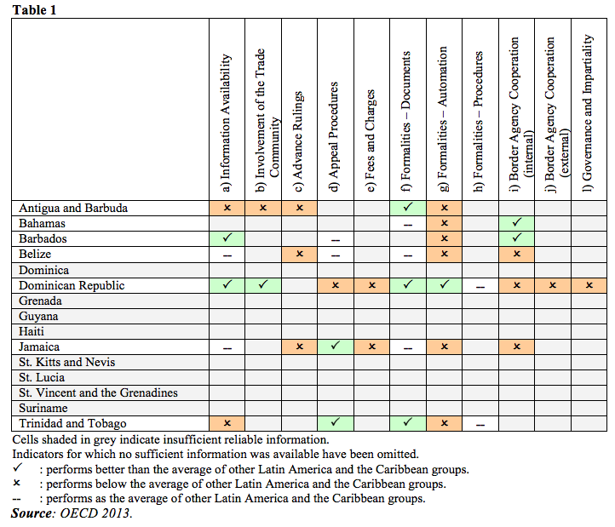
OECD TFIs Caribbean / Latin America

Slide 5
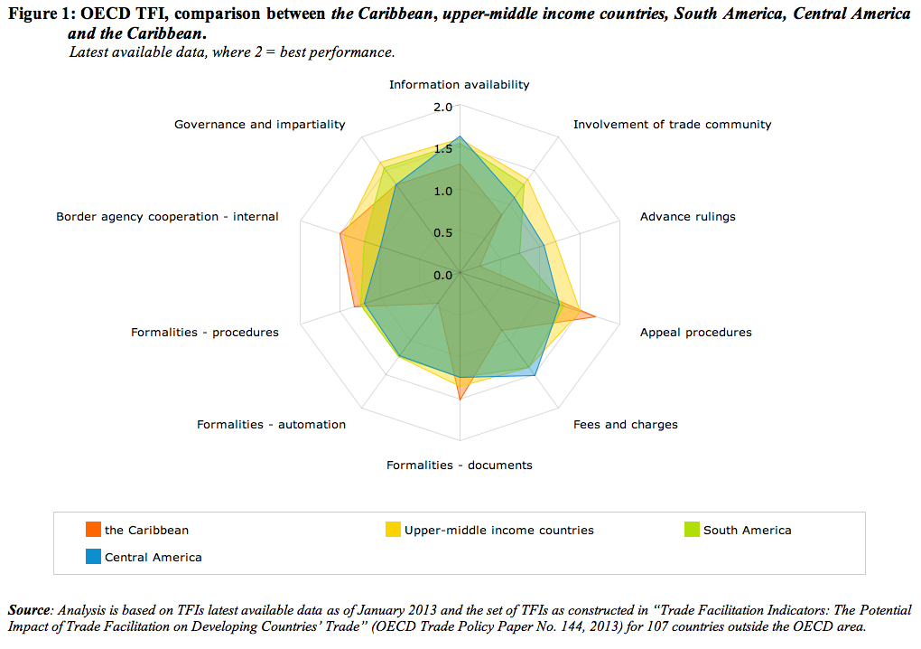
OECD TFI Caribbean / Latin America

Slide 6
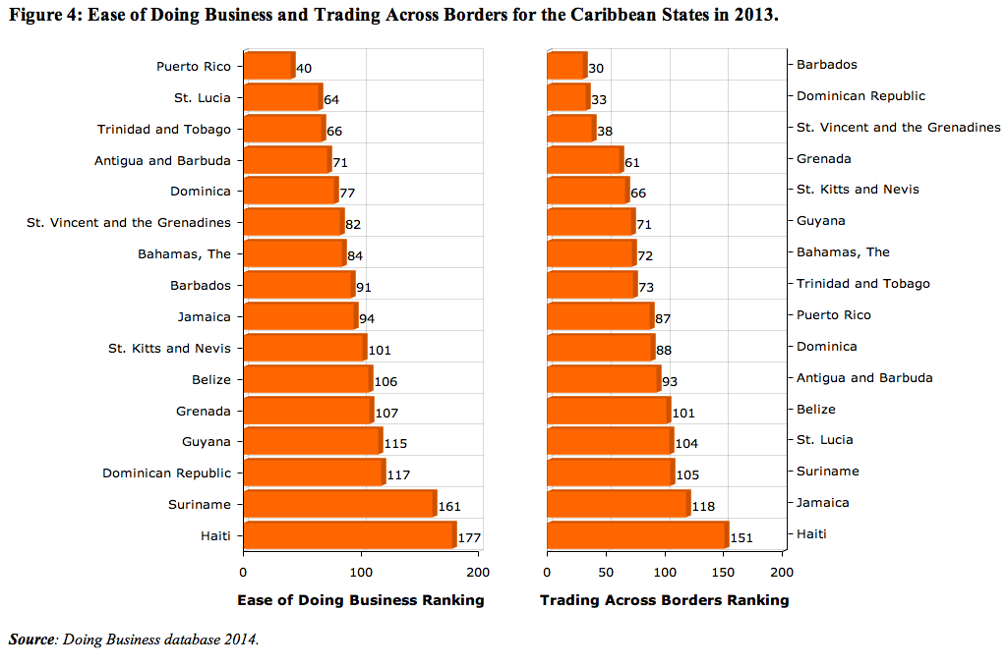
Ease of Doing Business and Trading Across Borders

Slide 7
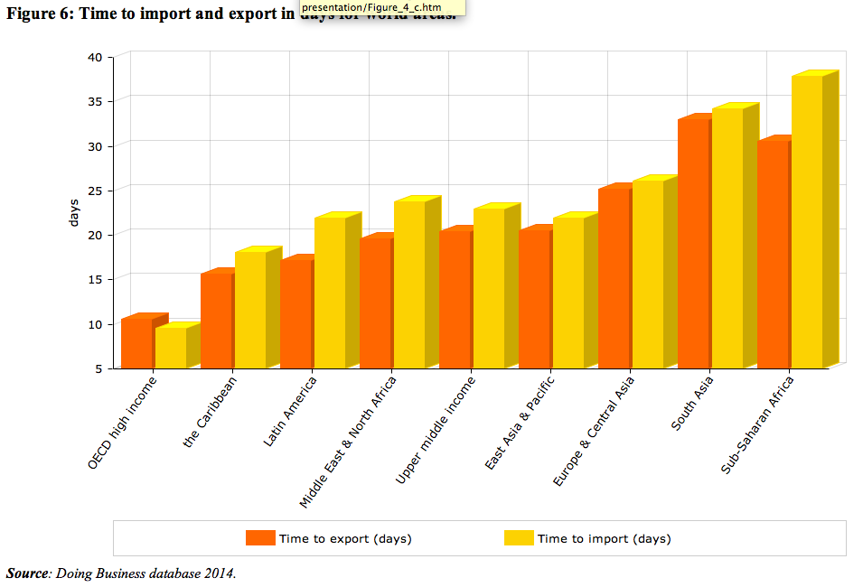
Time to import and export in days for world areas

Slide 8
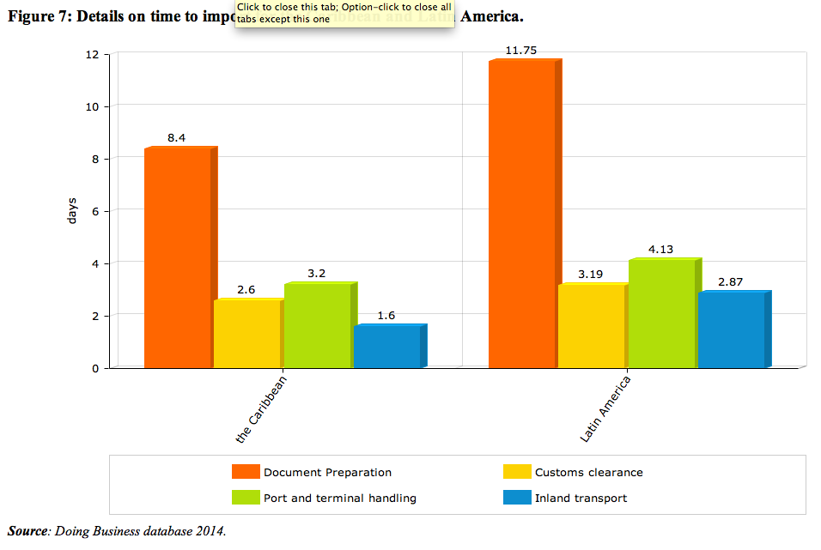
Time to import for the Caribbean and Latin America.

Slide 9
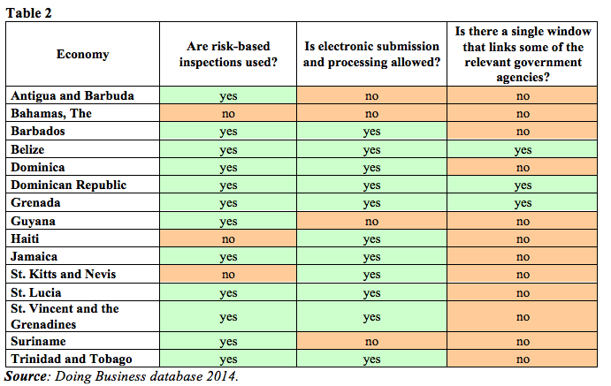
Good practices surveyed in Doing Business 2014

Slide 10
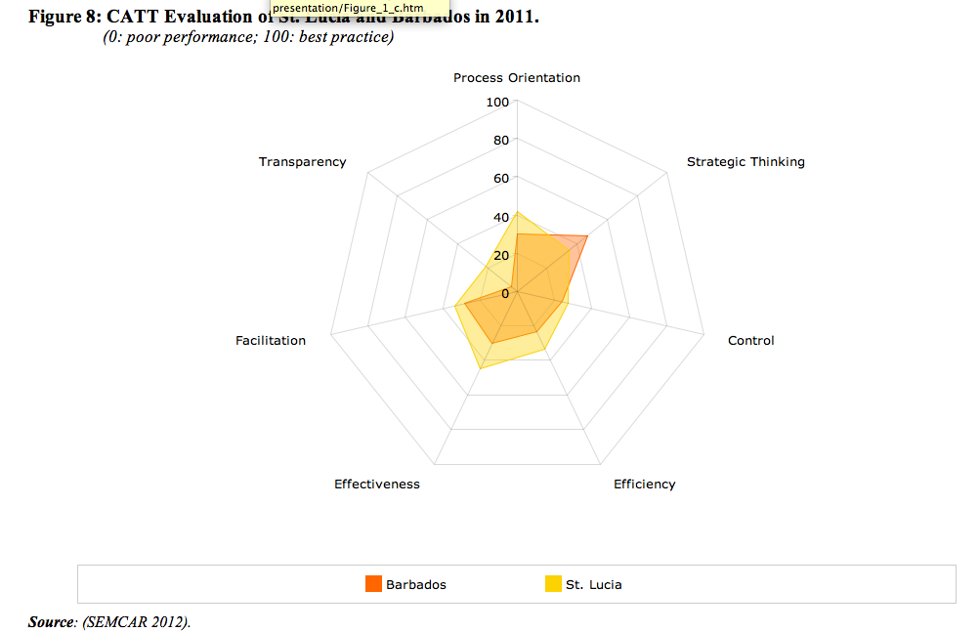
The CATT Evaluation of St. Lucia and Barbados in 2011

Slide 11
The CATT Results on Clearance time

Slide 12
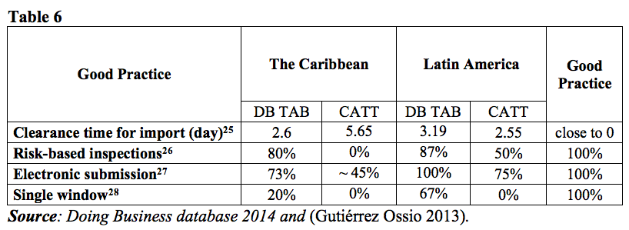
Comparing methodologies the CATT and DB
Notes:
It is not possible to make a proper comparison between the two methodologies. Nevertheless, it is possible to identify some aspects that could lead to these different scores.
This could be primarily due to the very precise domain covered by each indicator of the CATT, which narrows the field of scope making this framework very tailored to the evaluation of Customs administration. Also, different results could be explained by the high importance that CATT puts to objectivity and measurability of its indicators, which must be supported by evidence regardless of whom is accountable for collecting data and the corresponding evidence.

Slide 13
Comparing methodologies and results (1/2)
The Doing Business Trading Across Borders focuses on trade facilitation and, in particular, on time and costs.
The OECD TFIs and the CATT focus on trade facilitation but also cover the transparency of Customs administration.
Both methodologies are consistent in affirming that Customs in the Caribbean region could benefit from an increased engagement in reforms aimed at the implementation of best practices to reduce corruption and disseminate information.
Notes:
Due to its focus on trade facilitation and, in particular, on time and costs, the Doing Business Trading Across Borders does not cover the transparency of Customs administration.
On the contrary, other methodologies, such as the OECD Trade Facilitation Indicators (OECD TFIs) and the CATT assesses administrations on their procedures to limit and defeat trade-related corruption, thereby increasing ethics in Customs. In particular, the OECD TFIs provides several indicators that addresses transparency-related topics, such as Information Availability, Advance Rulings and Governance and Impartiality. The CATT tool also proposes the Transparency dimension.
Both methodologies are consistent in affirming that Customs in the Caribbean region could benefit from an increased engagement in reforms aimed at the implementation of best practices to reduce corruption and disseminate information.

Slide 14
Comparing methodologies and results (2/2)
According to both OECD TFIs and DB TAB, the Caribbean region performs better than Latin America in terms of simplification and harmonization of trade documents.
The Caribbean region performs well in streamlining of procedures, as indicated by OECD TFIs Formalities – Procedures.
Finally in relation to predictability, both Latin America and the Caribbean perform poorly according to both the CATT (Process Orientation) and OECD TFIs (Advance Rulings and Information Availability).
Notes:
According to both OECD TFIs (Formalities – Documents) and DB TAB (Number of documents), the Caribbean region performs better than Latin America in terms of simplification and harmonization of trade documents. Although the introduction of electronic single-window systems is not common in the countries of the Caribbean as it is in Latin American countries, the Caribbean region performs well in streamlining of procedures, as indicated by OECD TFIs Formalities – Procedures.
Finally in relation to predictability, both Latin America and the Caribbean perform poorly according to both the CATT (Process Orientation) and OECD TFIs (Advance Rulings and Information Availability).

Slide 15
Customs reforms in the Caribbean: Grenada (1/2)
The Administration's IT strategy played a critical role in the modernization process.
Today, traders are able to access the system 24/7 and this facilitates the access of traders to Customs from any location.
The system’s ability to interface with Grenada’s Port Authority has allowed real time data exchange.
A main web portal was realized to disseminate information on a timely basis.
Notes:
The Administration's IT strategy played a critical role in the modernization process.
Today, traders are able to access the system 24 hours a day, using the system through the Direct Trader Input (DTI) capability offered in the ICT system, and this facilitates the access of traders to Customs from any location. As a result, duplication of efforts has been eliminated, which has led to a significant reduction in the clearance time from days to hours at all ten Customs offices, and also to a more efficient deployment of staff.
As a means to further leverage the opportunities presented by their Customs system, a decision was taken to invest in handhelds devices giving officers the ability to electronically release cargo whilst on the floor, without having to return to their offices.

Slide 16
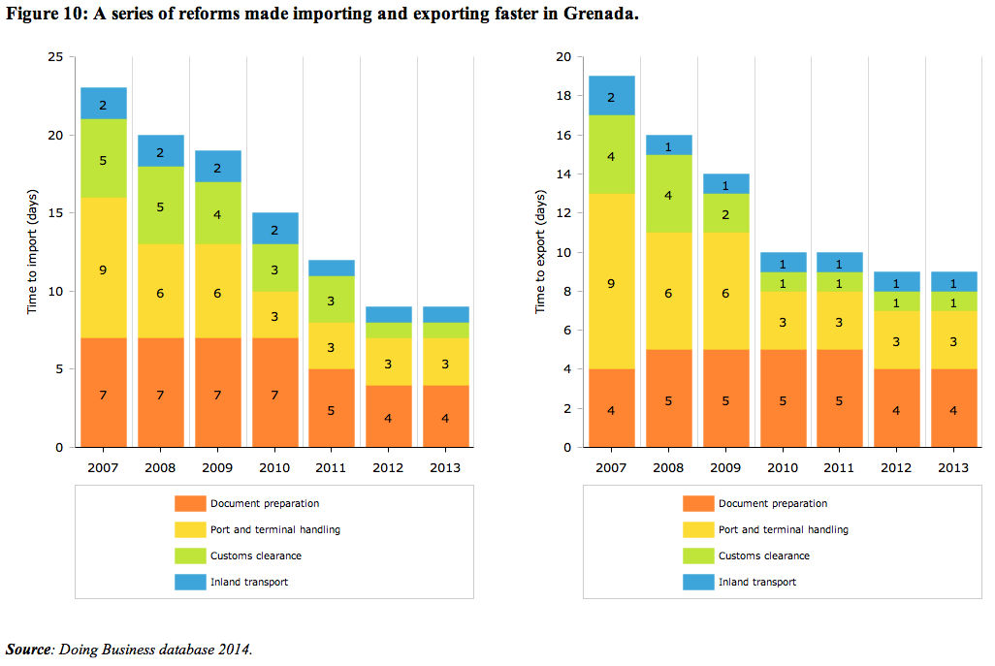
Customs reforms in the Caribbean: Grenada (2/2)

Slide 17
Customs reforms in the Caribbean: Trinidad and Tobago
Customs embarked on a reform and modernization programme and embraced information technology as one of its strategic tools for the attainment of its goals.
The system has over 1,250 end-users accessing the system nation-wide 24/7 with a daily average of 1,000 declarations electronically submitted.
The Government of Trinidad and Tobago has also embarked in setting up a single window system that will bring automation and connectivity to other trade-related government agencies that regulate the importation and exportation of goods.
Notes:
The twin-island Republic of Trinidad and Tobago is one of the largest economies in the Caribbean region with significant international trade volumes. The Customs and Excise Division of Trinidad and Tobago finds itself in a dynamic environment that places a very high demand on its services. As a consequence, the speed with which it clears import and export consignments plays a significant role in the countries' economic growth and development.
For this reason, Customs has embraced information technology as one of its strategic tools for the attainment of its goals. In order to create and sustain an enabling environment, which is conducive to investment and a stimulus of new trading opportunities, Customs embarked on a reform and modernization programme.

Slide 18
Conclusions (1/2)
Each methodology presented in this survey offers a different perspective bringing up valuable recommendations to high priority areas where reform initiatives and corrective measures are most required.
The macro view provided by DB TAB allows a quick assessment over trade facilitation and Customs efficiency that could lead to a thorough review fostering new reform programs.
Tools such as the CATT will provide more refined and accurate results targeting specific areas where corrective measures are needed.
Notes:
Although the methodologies presented in this paper vary in their design and objectives, each one offers a different perspective bringing up valuable recommendations to high priority areas where reform initiatives and corrective measures are most required. For instance, just by looking at the Doing Business rank on Trading Across Borders, it is easy for Customs Administrations to determine how complex regulatory requirements may be hindering their ability to score higher due to unnecessary documentary obligations. The macro view provided by DB TAB allows a quick assessment over trade facilitation and Customs efficiency that could lead to a thorough review fostering new reform programs. Likewise, tools such as CATT will yield similar results; however, the level of details and fact-based scores obtained through the assessment exercise would provide more refined and accurate results targeting specific areas where corrective measures are needed.

Slide 19
Conclusions (2/2)
ICT plays a substantial role in Customs reforms
in conveying information to decisions makers, whose results are objective and measurable, and
in enforcing good practices.
However, sophisticated computer applications are not enough to transform organisations.
Besides the proven positive aspects performance measurement tools bring to organizations, nothing replaces the need for a management or executive team capable of applying the concepts behind the methodologies.
Notes:
ICT also proved to play a substantial role in Customs reforms both in conveying information to decisions makers, whose results are objective and measurable, and in enforcing good practices; thereby enabling Customs Administration to become aware of their deficiencies and to ensure appropriate interventions are applied.
That being said, it is also clear that, besides the proven positive aspects performance measurement tools bring to organizations, nothing replaces the need for a management or executive team capable of applying the concepts behind the methodologies. Sophisticated business intelligence computer applications will not be able to transform organisations by themselves, unless properly used and applied by those responsible for managing and making decisions in Customs.

