Slide 1
Mineral taxation in Zambia: Development cooperation, performance indicators and improvements
Presentation of paper for FERDI conference on Measuring the performance of tax and customs administrations in developing countries.
Clermont Ferrand 12-13 June 2014
Jan Isaksen (CMI)
Gilbert Chinyama Kalyandu (Norwegian Embassy in Lusaka)

Slide 2
Contents
Introduction to the paper
The programme focus & some programme results
Developing the indicators
  Core programme indicators
  Complementary indicators
Using the indicators - problems and effects
Conclusions

Slide 3
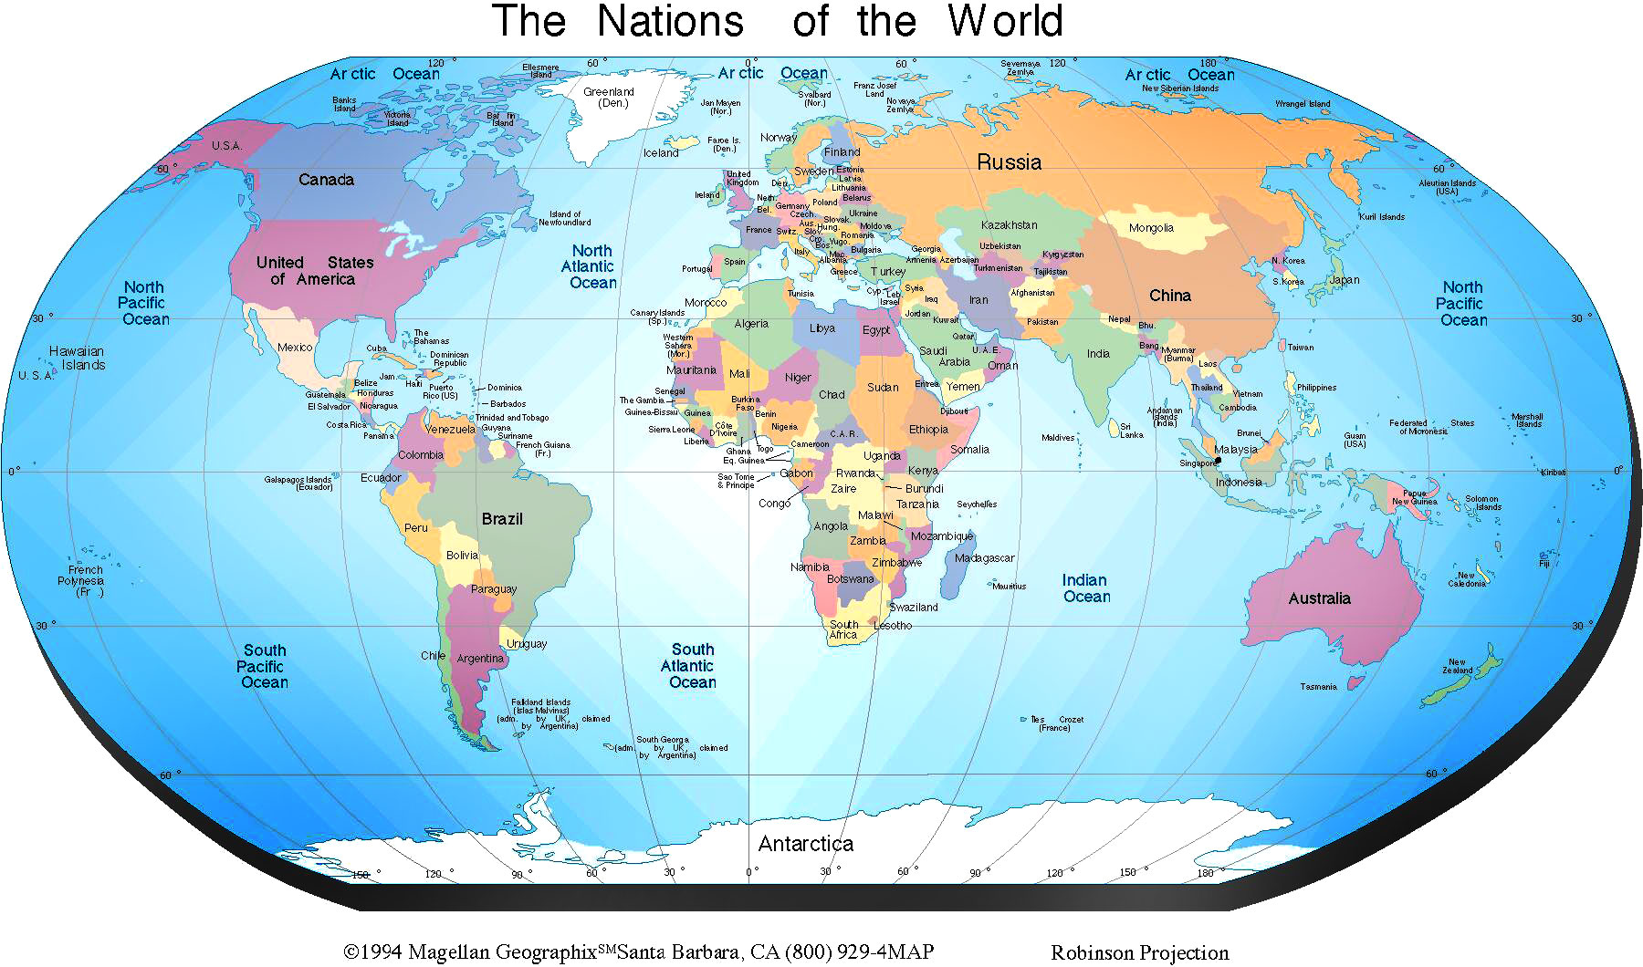
Introduction - Zambia

Slide 4
Introduction – Zambian Mining Sector
Country GDP US$18,507 billion approx. (2012)
Minerals - 80% of exports (2012)
Mining tax contribution to GDP 5.96% (2012)

Slide 5


Introduction – Mining Taxation
Economic management & fiscal policies dilemma
«From private ownership to nationalised mining sector (1971 Act) & back to private ownership (1995 Act)»
* Great expectations on re-privatisation
*Expectations short lived *Great public disatisfaction

Slide 6
Project background
Tax administration improvements
  In pursuit of remedies (DfID – 1994, Norway since 2006/7)
Mining Fiscal regime reform
  Development agreement re-negotiations
  Adjustments to fiscal and tax systems April 2007, April 2008 and April 2009
  New tax types inclusion e.g. windfall tax, variable profit tax
Specialised Large taxpayer administration in Zambia programme (2011)
  Norwegian support to tax administration specialisation (focus of the paper).

Slide 7
Some programme results…
Number of mining tax audits 2010-2013
Table 1: Number of mining tax audits 2010-2013
Source: ZRA
Tax audit type | 2010 | 2011 | 2012 | 2013 | Total
Desk audit | 12 | 42 | 27 | 66 | 147
Single tax audit | 13 | 22 | 19 | 15 | 69
Integrated audit | 4 | 8 | 8 | 14 | 34
Total audits | 29 | 72 | 54 | 95 | 250

Slide 8
Some programme results….
Tax audit re-assessments 2013
Description | K millions | US$ million
Prior years tax reassessments | 293 | 52
Tax audits reassessments collected 2013 | 88 | 15
Tax reassessed but not collected | 2382 | 426
VAT reassessed but contested | 6850 | 1227
VAT saved from VAT refunds | 2172 | 389

Slide 9
Developing the indicators…
Mapping stakeholders
Interest | High | CSOs, Media, professional Associations, Public | ZRA, ZAM Govt, Norwegian Embassy, Mining firms, IMF
 | Low |  | Trade Unions
 |  | Low | High
 |  | Power

Slide 10

Core programme indicators
International statistics influence
Revenue to GDP indicators
Compliance indicators
Tax audits indicators
….usual suspects

Slide 11

Complementary indicators
…..a balancing act…
Measuring institutional cooperation/technical assistance
ZRA Corporate Strategy indicators
Non measurable aspects
Descriptive indicators

Slide 12

Walking the walk - using the indicators

Slide 13
Using the indicators - problems and effects I
Statistical Challenges
  Use of in-house data
  The GDP ratio and GDP methodology revisions
Indicators and organisational/ procedural reforms
  No direct triggering of changes…
  .. but a lot of indirect effects
    ZRA corporate strategic plan
    VAT investigation
    Tax policy
    Influence on GIZ programme

Slide 14
Using the indicators - problems and effects II
Quantification as a double good
  Quantity indicators measure, Qualitative indicators encourage
  Zambian programme has quantity indicators: limited double use
Quantification & pragmatism
  Original indicators kept, new indicators added
    Taxpayers Charter
    Fraud – Internal Affairs Unit
    Donor activities description / indicator?

Slide 15
Using the indicators - problems and effects III
Indicators and civil service
  Indicators contributed to change in traditional civ service view
  Visibility of programme and contagion effect within ZRA
  Indicators led to more positive external exposure of ZRA activities and staff
Avant-garde for northern thinking and views?
  A certain amount of donor pressure contributed to ZRAs acceptance of the principle of indicators
  Participative process in construction of indicators increased ZRA ownership
  Parallel work on ZRA strategic plan indicators led to cross fertilization

Slide 16
Using the indicators - problems and effects IV
Taxpayers & indicators
  Results not well communicated to taxpayers
  Problem of indicators for taxpayer education (selected indicator pushes number of activities but real issue is positive change in attitudes)
Indicators & non measurable results
  Can staff integrity be measured by number of cases of misconduct/fraud?
  Attribution problem again
  Soft value indicators being pushed our by hard ones and the perceived need for international comparisons.

Slide 17

Conclusions…..
…Are we looking good?

Slide 18
Conclusions….
Result indicators and perfection
  Zambia indicators not theoretically perfect in measuring results but still useful
Circumspection in indicators use
  Indicators of the ZRA-NTA programme best used as entry points for considering results and further action
Donor push for indicators - stakeholder acceptance
  Northernism by push of indicator concept. Selection of system and individual indicators brought ownership to ZRA

Slide 19
Conclusions…..
International indicators influence
Quantitative indicators in real sense measure
  not directly encourage change
Actions and results report and their impact on stakeholders
  Contagion effect and attraction effect
  But if the programme had not been as successful…?
Performance measurements and flexibility
  Flexibility exists. Indicators not laid down in agreement
  New indicators along the way

Slide 20
Conclusions
Multiple donor support to ZRA and performance measurement
  Danger of overlapping work and indicators but ZRA seem to have managed to use synergies
Statistical challenges
  GDP problem
Non-measurables - staff and taxpayer attitude
  Surveys or indicators

Slide 21
THANK YOU
THANK YOU

