Slide 1


REASSESSING THE ROLE OF SPECIAL ECONOMIC ZONES IN AFRICA
Evidence on Export
Performance and
Socioeconomic Impacts
Part 2
Consultation meeting, FERDI-AFD
23 June 2026
Azuelos, Boubekeur, Gourdon, Githinji, Hornok, Mulyukova, Ouari
AFD Research Paper — Juin 2025
Part 3. Exploring the transformation of Special Economic Zones in Africa

Slide 2

1
BACKGROUND
AU Policy: SEZ contribution to SME integration and local economic development
CONTENTS
2
SEZ MODELS
New generation SEZ business model characteristics
3
SDIs
Regional development at the core of new generation SEZs

Slide 3

1
BACKGROUND
AU Policy: SEZ Contribution to SME Integration & Local Economic Development
CONTENTS
2
SEZ MODELS
New Generation SEZ Business Model Characteristics
3
SDIs
Regional Development at the Core of New Generation SEZs

Slide 4
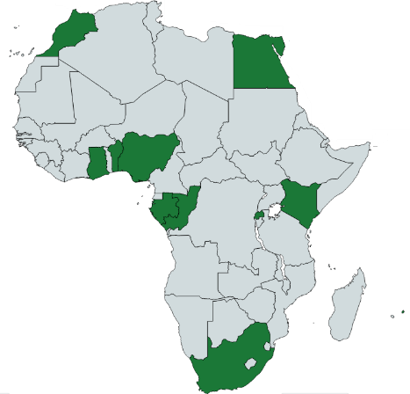
SCOPE OF AFRICAN UNION POLICY REPORT
SEZ Contribution to SME Integration & Local Economic Development
Draw on successful practices from 10 countries across 5 regions in Africa. 37 SEZs analyzed with representative sample of coastal and landlock countries.
Advocate for modern governance and regulatory frameworks to integrate SMEs into SEZs and to boost local economies
Benin, Egypt, Gabon, Ghana, Kenya, Mauritius, Morocco, Nigeria Rwanda, South Africa
Underscores the importance of aligning SEZs investment with ESG principles to attract responsible investment.
Encourage partnerships between SEZs, private sector organizations and financial institutions, to creating sustainable markets and appropriate financial mechanisms
Emphasizes the role of SEZs as hubs for implementing the African Continental Free Trade Agreement (AfCFTA) agenda.
Encourages subcontracting and outsourcing initiatives from large companies operating in SEZs and SMEs
Project finance by AFD and implemented by Expertise France in the framework of the France Africa Union Technical Facility
Serves as a guide for governments to reform policies, attract sustainable investments, and support a new generation of SEZs as engines of inclusive and sustainable development.

Slide 5
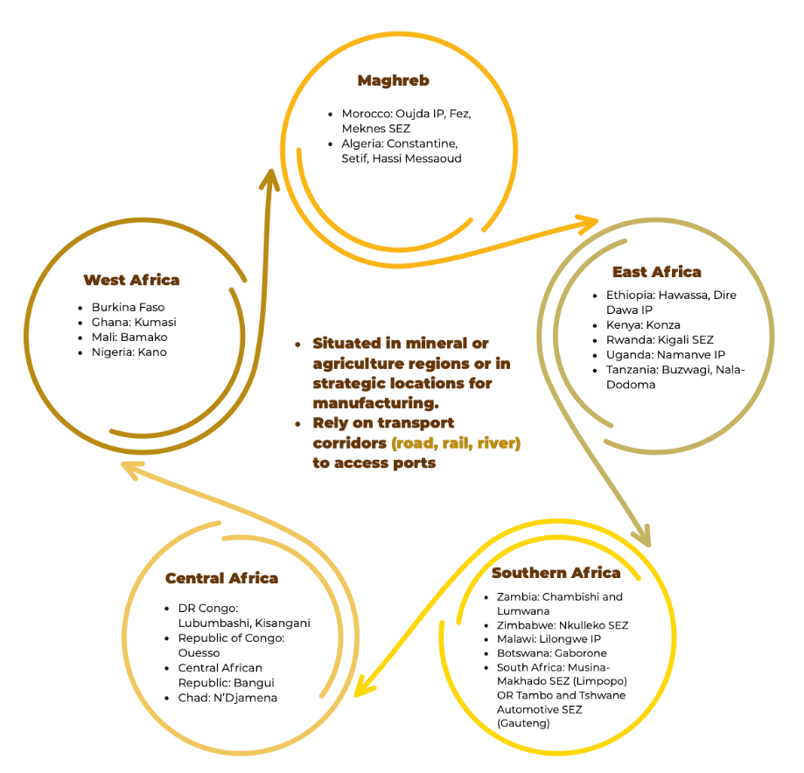
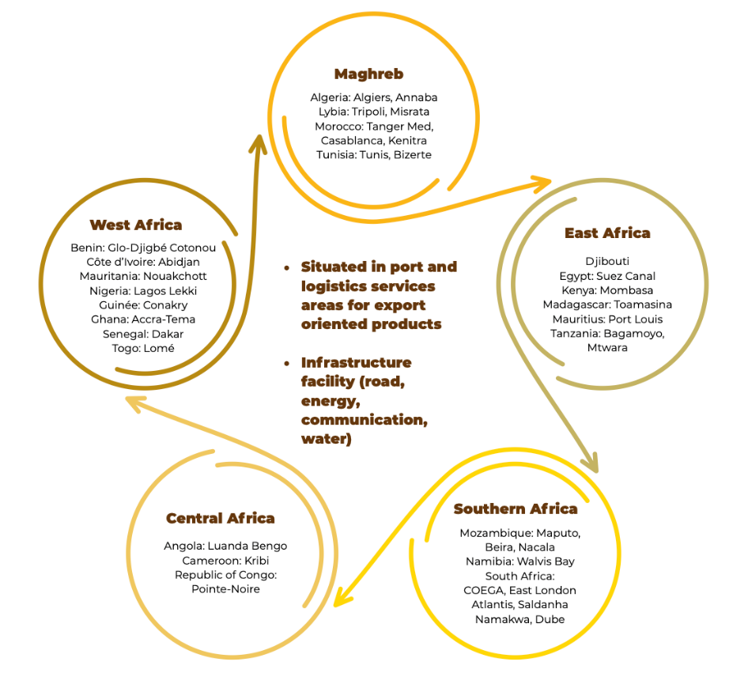
SEZs MINERAL-AGRICULTURE & LOGISTICS ORIENTED

Slide 6

SEZs GOVERNANCE STRUCTURE MODELS
PRIVATE
PPP
PUBLIC
Investors retain full control over development, management, and operations , but face high-risk exposure due to significant infrastructure costs and limited access to host-country. incentives.
Government-led SEZ development aligns zone sectors and industries with national industrial and growth policy goals, enabling oversight and monitoring of SEZ activities.
Risk-sharing model combining public infrastructure interest and private market expertise
A model driven by land value capture
Generous FDI tax incentives erode public revenue
Job creation focus
STAKEHOLDER ROLES IN SEZ MODELS
GOVERNMENT ENABLING ROLE
Four core stakeholder roles govern all SEZ models
Government's enabling role is indispensable across all governance types: reducing regulatory burdens, facilitating ease of doing business, and developing a skilled workforce aligned with SEZ demand.
Regulator
Operator
Developer
Operator-Manager

Slide 7
SYSTEMIC CHALLENGES CONSTRAINING SEZs
LIMITED
LINKAGES
GOVERNANCE
GAPS
STRUCTURAL
BARRIERS
Weak integration between SEZ firms and local supply chains and limited use of local contents
Minimal technology and knowledge transfer to domestic industries
Weak impact on local economic development due to export-oriented SEZs
Inconsistent regulatory frameworks across zones and jurisdictions
Overlapping mandates between zone authorities and national agencies
Lack of conducive business environment affect investor confidence
STRUCTURAL
BARRIERS
GOVERNANCE GAPS
Critical infrastructure deficits (inadequate roads, ports)
Unreliable power and internet connectivity
Africa's infrastructure gap estimated to cost 2–4% of GDP annually and suppress firm-level productivity by up to 40% (UNECA)

Slide 8
SEZ CHALLENGES AND REGULATORY FRAMEWORK UNDER AfCFTA
CHALLENGES
REGULATORY FRAMEWORK
WEAK CUSTOMS
RULES OF ORIGIN
(MINISTERIAL REGULATION 1/2023)
Manual procedures slow trade flows
Weak interoperability between customs systems
Accelerate digital customs adoption.
Implement single window systems
SEZ goods qualify for AfCFTA tariff preferences only if they meet defined origin criteria
SEZ REGISTRATION & COMPLIANCE
COMPLEX RULES OF ORIGIN & WEAK CUSTOMS
Must register with AfCFTA Secretariat for preferential benefits
Ensures SEZ policy alignment with AfCFTA regulations
Cumbersome origin verification
Ameliorate traceability systems
TRADE REMEDIES PROTOCOL
COMPETITION WITH LOCAL MARKETS
Allows countries to protect domestic industries from unfair SEZ competition. Balances trade liberalization with safeguards.
Domestic industry concerns on price and volume competition
Strengthen supplier development + subcontracting-outsourcing industrial and services activities between SEZ companies and SMEs

Slide 9
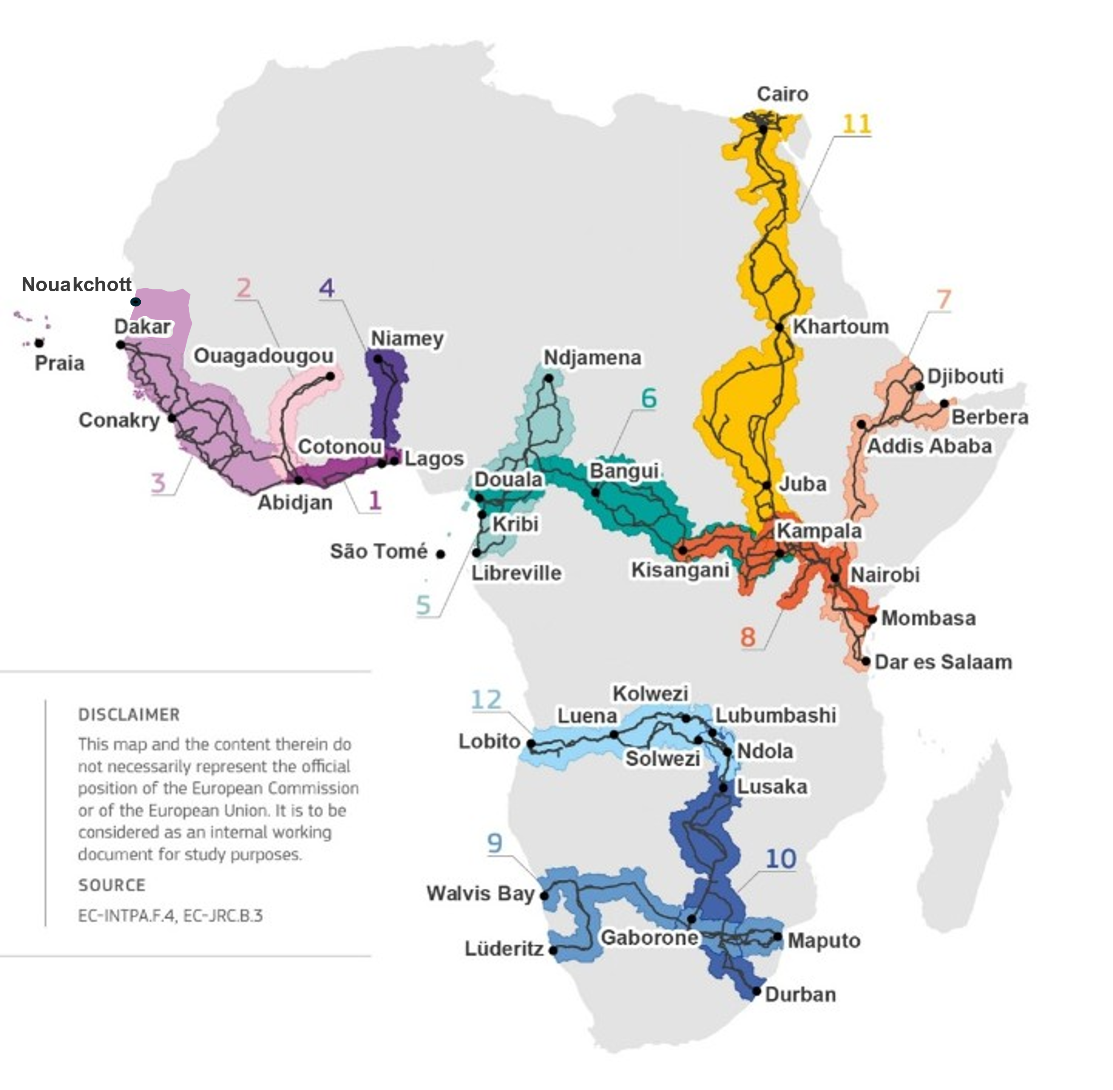
TRANSPORT CORRIDORS FOR SEZ DEVELOPMENT
Significant progress but persistent challenges
1. Abidjan-Lagos
West Africa: Côte d’Ivoire, Ghana, Togo, Benin, Nigeria
2. Abidjan-Ouagadougou
West Africa: Côte d’Ivoire, Burkina Faso
3. Dakar-Abidjan
West Africa: Mauritania, Senegal, Gambia, Guinea-Bissau, Guinea, Sierra Leone, Liberia, Côte d’Ivoire, Cabo Verde
4. Cotonou-Niamey
West Africa: Benin, Niger
5. Libreville-Kribi-Douala-N’Djamena
Central Africa: Gabon, Equatorial Guinea, Cameroon, Chad, São Tomé and Príncipe
6. Douala-Kribi-Kampala
Central Africa: Cameroon, Central African Republic, Democratic Republic of the Congo, Uganda
7. Dar es Salaam-Nairobi-Addis Ababa-Berbera-Djibouti
East Africa: Tanzania, Kenya, Ethiopia, Somalia, Djibouti
8. Mombasa-Kisangani
East Africa: Kenya, Uganda, Rwanda, Democratic Republic of the Congo
9. Maputo-Gaborone-Walvis Bay
Southern Africa: Mozambique, South Africa, Eswatini, Botswana, Namibia
10. Durban-Lusaka-Lubumbashi
Southern Africa: South Africa, Botswana, Zimbabwe, Zambia
11. Cairo-Khartoum-Juba-Kampala
North and East Africa: Egypt, Soudan, South Sudan, Uganda
12. Lobito-Kolwezi-Lubumbashi/Solwezi-Ndola
Southern and Central Africa: Angola, Democratic Republic of the Congo, Zambia
75% of trade delays due to weak governance structures, complex border procedures, administrative bottlenecks, inconsistent regulatory enforcement across countries and Inadequate monitoring and data collection systems preventing performance assessment.
Investments are largely concentrated on the construction of roads and highways, while the maintenance of road networks faces serious challenges due to insufficient financing of Road Funds.

Slide 10

1
BACKGROUND
AU Policy: SEZ Contribution to SME Integration & Local Economic Development
CONTENTS
2
SEZ MODELS
New Generation SEZ Business Model Characteristics
3
SDIs
Regional Development at the Core of New Generation SEZs

Slide 11







TOWARDS INTEGRATED INDUSTRIAL, SERVICES, AND LOGISTICS HUBS
INTEGRATED OFFERING
MARKET ACCESS
Integrated industrial, services and logistic hubs with enhanced resource value and local content integration
Regional, AfCFTA, and global market access through strategic positioning
STRATEGIC LOCATION
TECHNOLOGY INNOVATION
Mineral-rich hinterlands, agricultural products, port zones, and transport corridors
AI-driven logistics and Real-time Enterprise Resource Planning platforms

Slide 12
ESG STANDARDS AS A COMPETITIVE DRIVER FOR NEW GENERATION SEZs
CORE BUSINESS OPPORTUNITY
ENVIRONMENTAL COMPLIANCE
SOCIAL
INCLUSION
GOVERNANCE
TRANSPARENCY
ESG has shifted from compliance obligation to core business opportunity
SEZs demonstrating environmental responsibility, social inclusion, and governance transparency are better positioned to attract green bonds, SDG-linked finance, and institutional capital.
Adoption of green technology (solar, renewable), circular economy, waste recycling, and pollution control .
EU Carbon Border Adjustment Mechanism (CBAM) and similar regulations are pushing SEZ investors toward lower-carbon operations.
Gender equality and
equity
Women and youth employment
Community-based integration
Fair labour standards
Vocational training
Anti-corruption governance frameworks
Blockchain-based traceability digital tools that enable to secure, track and verify products, transactions, and information throughout a value chain.
Digital monitoring and reporting are becoming standard practice.

Slide 13









ONGOING SEZ INITIATIVES
Paving the Way for New Generation SEZs
Benin
Egypt
Rwanda
Morocco
Mauritius
Agro-industry and textiles with business incubators and SDG bonds for renewable energy
ICT, automotive, and textiles integrated with tax incentives and Intilaq entrepreneurship programs
Kigali SEZ connecting TVET and innovation hubs to drive "Made in Rwanda" exports.
Rwanda's Business Development Fund (BDF) model for SME financing
Tangier-Med SEZ enforcing local content requirements through automotive and logistics SME partnerships
SEZ workforce strategy aligned with ICT and financial services skills development programs
South Africa
Nigeria
Gabon
Kenya
Bottom-up approach empowering MSMEs before attracting foreign direct investment, focused on green technology cluster development
Supported by Invest SA-WESGRO and GreenCape organisation.
"Made in Nigeria for Export" (MINE) targeting exports via Lekki Free Trade Zone
Forest Stewardship Council (FSC) certified timber processing and circular economy initiatives.
Nkok SEZ partnering with training centers for timber industry skills
Tatu City SEZ model.
KIRDI R&D support for manufacturing competitiveness

Slide 14
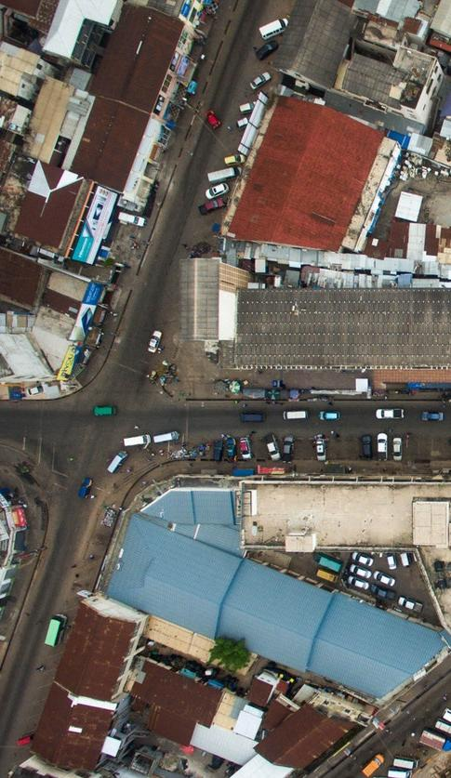
1
BACKGROUND
AU Policy: SEZ Contribution to SME Integration & Local Economic Development
CONTENTS
2
SEZ MODELS
New Generation SEZ Business Model Characteristics
3
SDIs
Regional Development at the Core of New Generation SEZs

Slide 15
SPATIAL DEVELOPMENT INITIATIVES
A framework for local economic development
SDI GOVERNANCE
OVERVIEW
INTEGRATION
LEVELS
Strategic Investment Frameworks
SDIs are strategic frameworks guiding public-private investment in land use, infrastructure, mobility, human resources, and environmental resilience
Multi-Sector Coordination
Comprehensive coordination across multiple sectors and governance levels
1. Vertical Integration
National-Regional-Municipal policy alignment
2. Horizontal Integration
Land use, transport, environment, and social services coordination
CRITICAL SDI IMPLEMENTATION CHALLENGES
Persistent infrastructure deficits – limiting connectivity
Financing gaps – preventing timely execution of planned operations
Project implementation delays – Due to bureaucratic bottlenecks
Weak governance accountability – Undermining coordination
Environmental impact assessments – Water scarcity and mining discharge extending timelines

Slide 16
SEZ INTEGRATION IN SPATIAL DEVELOPMENT INITIATIVES
South Africa: A reference model
1. Richards Bay IDZ (KwaZulu-Natal)
3. COEGA IDZ (Eastern Cape)
5. Limpopo SDO (Limpopo)
Integrated with Nelson Mandela Bay Municipality (NMBM) for regional economic development. Dedicated SME upgrading program with local impact targets. Planned vaccine manufacturing hub and 440-hectare aquaculture project for ocean economy acceleration.
Musina-Makhado SEZ positioned as logistics hub along North-South corridor to Zimbabwe. Target sectors: energy, mining, agro-processing, light manufacturing. Environmental impact assessment addressing water scarcity and mining discharge is prerequisite for approval. Success factor across all cases: public-private collaboration across national, provincial, municipal authorities.
Supplier Development Program supporting local SMEs, strategically linked to the Maputo Corridor trade route
1
2
3
4
5
2. Saldanha Bay IDZ (Western Cape)
4. East London IDZ (ELIDZ) (Eastern Cape)
Marginalized coastal region transformed into a dynamic industrial zone . Saldanha Bay IDZ has contributed to local economic development through industrial diversification, job creation, infrastructure upgrading, skills development, and the attraction of investment linked to the maritime, logistics, energy, and oil and gas service sectors.
Automotive manufacturing, agro-processing, and renewable energy focus. Local SME engineering service contracts enhance regional workforce technical capabilities and create sustainable supplier relationships.

Slide 17
NAMIBIA’S WALVIS BAY EXPORT PROCESSING ZONE
Port-Centric Spatial Development Initiative
GOVERNANCE
MODEL
FOUR KEY CORRIDORS
URBAN PLANNING
2022 - 2042
CLIMATE STRATEGY
National Coordinating Committee led by Namibia Investment Promotion & Development Board and involving Ministry of Public Enterprises, Walvis Bay Industrial Development Initiative and Namport authorities
National Single Window system
SEZ for raw material processing.
Trans-Kalahari
(Botswana-Gauteng-Maputo)
Walvis Bay-Ndola-Lubumbashi
(DRC-Malawi- Zambia- Zimbabwe)
Trans-Cunene (Southern Angola)
Trans-Oranje
(South Africa's Northern Cape).
Reduce urban migration
Social housing with recreation
Desalination
Road-rail upgrades
Financial sustainability via revenue increase and PPP
Academic collaboration on climate impact preparation,
Supports desalination projects

Slide 18
POLICY RECOMMENDATIONS FOR NEW GENERATION SEZs
GOVERNANCE MODEL
INFRASTRUCTURE DEVELOPMENT
LOCAL PARTICIPATION & SME INTEGRATION
REDUCED TAX DEPENDENCY
Effective oversight
Policy accountability
Strengthened Board representativeness (participation of the private sector and improved gender) balance.
Embed SEZs in transport corridors
Reliable utilities
Digital infrastructure
Integrated services (interoperability of systems)
SME–Large enterprise linkages
Local resource utilization
Technology transfer
Skills development
Access to finance
Diversify revenue sources
Reduce tax dependency
Fiscal sustainability
Alternative income streams
TRANSITIONING TO EMERGING SECTORs
MANDATORY ESG COMPLIANCE
BEST PRACTICES &
PEER LEARNING
ALIGNMENT WITH AFCFTA OPPORTUNITIES
Invest in renewables, communication technology, biotech, Artificial Intelligence
Circular economy
Mandatory ESG standards
Sustainable business practices
ESG monitoring systems
Learn from Atlantis SEZ & Tatu City
Benchmark African best practices
Promote peer learning
Position SEZs for AfCFTA
Traceability systems of trade goods
Accelerate customs digitalisation systems
SPATIAL DEVELOPMENT
INITIATIVE AS
A FRAMEWORK
Align SEZ Policies with Spatial Development
Ensure coherence between land use planning, infrastructure investment, and SEZ development
Promote balanced regional development to reduce disparities

Slide 19
CONTACT
Julien Gourdon, Economiste
Agence Française de Développement
gourdonj@afd.fr
Dr. Sid Boubekeur
Associate Expert, Imani Development
Sid.boubekeur3@gmail.com

