Slide 1



The Customs Assessment Trade Toolkit (CATT)
Enrique Fanta
World Bank
June 2014
www.customscatt.org

Slide 2
Features – What is CATT?
An integrated monitoring tool for measuring Customs performance over time.
Used to evaluate the relative strengths and weaknesses of any Customs administration and compare them to best practices.
All data is objectively verifiable and comparable across countries and across time periods.
Reports are automated. The tool is multilingual, English French and Spanish

Slide 3
Background
The tool was developed in the LAC region in 2010 with financing from Bank budget and different Trust Funds
International partner organizations that were consulted in the development of the tool include e.g. World Customs Organization, Word Trade Organization, International Chamber of Commerce, IMF, EU and bilateral donors.
A third version of the methodology (‘CATT3’) is currently in the development stage,

Slide 4
Strong Demand
The tool has been performed in Mexico, Colombia, Peru, Costa Rica, El Salvador, Nicaragua, Paraguay, Suriname Jamaica, St. Lucia, Barbados, Saint Vincent and the Grenadines, Trinidad and Tobago, Dominica, Paraguay, Brazil, Haiti and Benin. In now being applied in Salvador and Mauritania
Mexico has done the CATT twice and used the results for their strategic planning. Nicaragua, El Salvador and Colombia are adopting CATT as their tool for measuring Customs performance
Several countries have asked to repeat the CATT and some have requested follow up technical assistance. Already done in Mexico, Colombia and in Nicaragua, now going to El Salvador
The CATT assessments are currently planned for Guatemala, Guinea and Chile.
Outside the LAC region, Georgia, Armenia, Azerbaijan, Pakistan, Madagascar and Tunisia have expressed interest of conducting the CATT. Also working to perform together with IAMTAX in Croatia, Belarus and Ukraine. In Africa region is planned to carry out CATT in Guinea, Mauritania, Cote D’Ivoire and Burkina Faso.

Slide 5
Assessment
Assessment of a Customs office using 120 indicators in seven dimensions
Indicators benchmark individual best practices, collected from the literature as seen in http://www.customscatt.org
CATT has Spanish, English and French version

Slide 6
Dimensions
Process Orientation: Measures the degree in which the customs office manages its formal processes, regulations, procedures and documentation, as well as the degree in which the office can improve on the formal aspects of managing a customs office.
Strategic Thinking: Measures the ability of the customs office to seek innovation and imagine new and different futures that may lead the organization to redefine its core strategies to improve according to some defined master plan, and includes such important issues as the existence of a modernization program and the existence of strategic plans.
Control: Measures the ability of the customs office to enforce compliance with Customs law and helps generate the sense of risk through improved methods of control.

Slide 7
Dimensions
Efficiency: Measures the ability of the customs office to achieve results with minimum cost and the ability of the customs office to get things done quickly; excise taxes effectively, process declarations and customs procedure quickly, etc.
Effectiveness: Measures the ability of the customs office to get the right things done and the quality of the organizational structures needed for the operation of an effective customs office. This measures infrastructure, technology, training, physical resources, laboratories, budget, etc.
Facilitation: Measures the ability of the customs office to make tasks for its customers and trade operators easy and simple.
Transparency: Measures the ease with which trade operators, internal and external users can gain access to information held by customs.

Slide 8
Organization of Indicators
7 DIMENSIONS
11
A
R
E
A
S

Slide 9
Indicators by dimensions

Slide 10
Reporting Results – Basic Dimensions

Slide 11
Reporting Results – Basic Dimensions

Slide 12

Customs Toolkit: Performance Indicators

Slide 13
Reporting on Key Indicators
  120 indicators, in 10 functional categories
  The toolkit do not just collect the “number”, but all the metadata necessary o understand the indicator.

Slide 14
How Each Toolkit Card Looks Like…
  Information associated to each
  Indicator:
  Area
  Detailed Description
  Weight and Type of Indicator
  Measurement Order
  Good Practice
  Verification Mechanism
  Measurement Methodology
  Sources of Information
  Formula to Calculate the Indicator
  Normalization Rules
  Additional Methodological Comments
  Dimensions Affected by the Indicator

Slide 15

Web System Roadmap

Slide 16
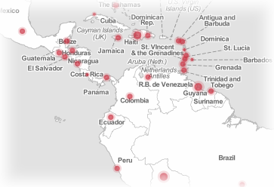
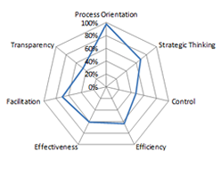
Goals
Measure
Compare
Store
2008
2009
2010
2011
2012
Customs Performance
Across Countries
Over Time

Slide 17
Web System Functions
Manage CATT methodology
Joint Evaluators
Perform a country assessment
Get assistance for the methodology
Customs Offices
Perform self assessment
General Population
Provide support for evaluators
Make suggestions on methodology
Generate country report
Get assistance for methodology
Maintain digital library
World Bank
View CATT country evaluation reports
Generate self assessment report
View/Compare CATT Results

Slide 18
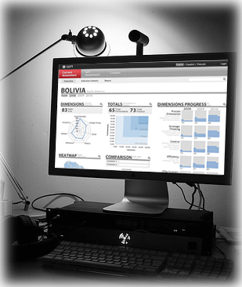
Presentation
User friendly and easy to use
Multilingual
World class Web system
Authenticated use only
Uses web forms best practices

Slide 19
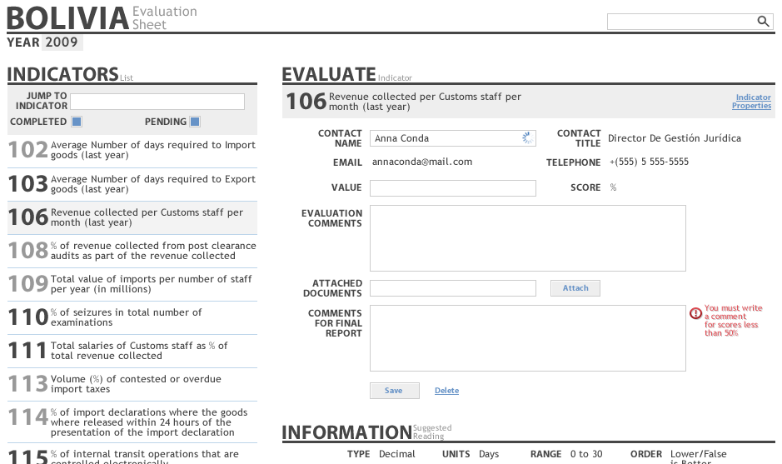
Filling Indicators
Indicator Selector
Indicator Measurement Area

Slide 20
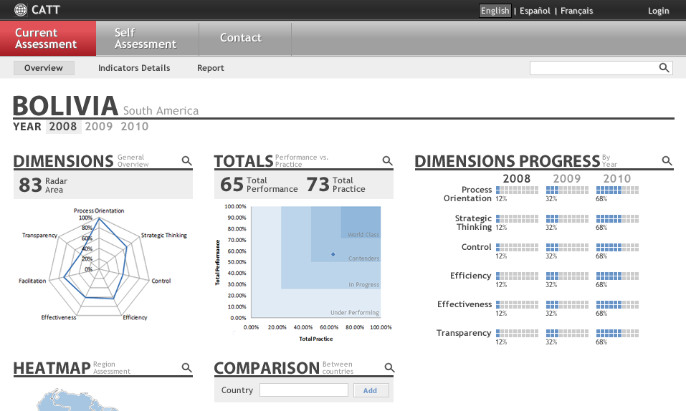
Analyzing Country Assessment

Slide 21
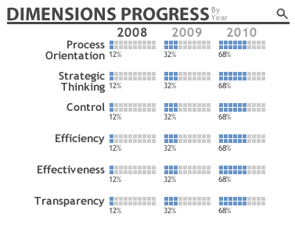
Measure progress by dimensions
View specific dimension values per year to analyze progress

Slide 22
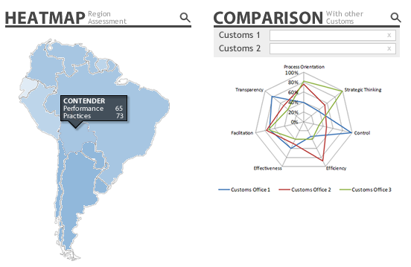
Comparison Tools for Country
Easy comparison in the region and any other country

Slide 23
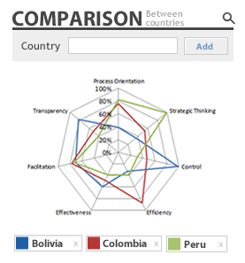
Comparison Tools
Comparisons between any country along all six dimensions

Slide 24
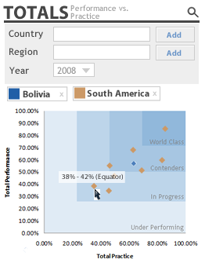
Comparison Tools
Compare country totals against other countries or entire regions
Select a particular year

Slide 25
Pilots Lessons Learned
Counterparts were interested in applying the tool to evaluate their relative strengths and weaknesses based on objective information and evidence
Also they were motivated to know about what kind of customs are they (world class, contender, in progress, or underperforming)
They worth the integral feature of the tool since not only customs aspects are evaluated but also other related ones to support customs (HR, IT, budget) and the flexibility of the tool to incorporate different kind of methods to measure the indicators
When the customs are integrated with internal revenue (as both pilots), the tool evaluated common offices as well such as audit and risk management.

Slide 26
Pilots Lessons Learned
The evaluation enabled the customs and those offices to realize how critical sound coordination among them is for improving customs performance
Also they were interested to know their relative position in comparison with other pilots (what administration is better evaluated, in which dimensions)
Comparing Colombia with Mexico for the former took more than two months to complete the report. In the case of Mexico with the Web application with interesting results were ready in two weeks.
The pilots by themselves will explore whether the tool might fit to evaluate their own customs administrations especially Mexico

Slide 27
Pilots Lessons Learned
The methodology might fit very well in the doing business agenda whether the country is interested on improving the DB scores.
In that sense the methodology might provide evidence and arguments to justify better the scores attained.
Five weeks preparation for LAC countries is fine, but less developed countries have required sometimes more than 8 weeks

Slide 28
CATT 3
Focusing on domestic benchmarking rather international one
  Continue with the “good international practice approach”
  Opening y/n t/f indicators
Working closely with WCO and international community for adopting WCO standards, by
  Using WCO glossary
  Using WCO capacity building framework for ensuring all needed indicators are included
  Including Revised Kyoto Convention defined practices as primary good international practice
  Including WTO agreement on Trade Facilitation

