Slide 1


The Long Road to African Integration Remarks
Jaime de Melo
ECIC 2025, UOM, December 3-4 2025

Slide 2
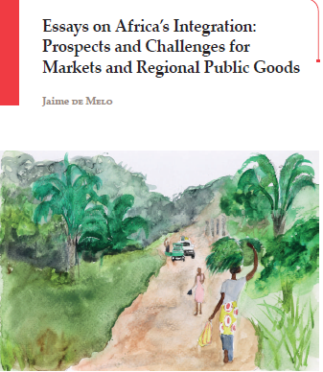
Part I (Challenges and Pathways) examines Africa’s continued de-industrialization and the constraints hindering structural transformation: notably, labor costs that are high relative to income levels, and weak non-tradable sectors that prevent the continent from realizing its potential in labor-intensive manufacturing.
Part II (Architecture Choices) addresses the design trade-offs facing regional integration—between membership size, depth of integration, and differentiated treatment. In the absence of compensation mechanisms, integration often amplifies disparities between diverse economies. Flexibility becomes essential to accommodate overlapping memberships and varied national interests.
Part III (Deliverables for the AfCFTA) focuses on the operational challenges of building regional value chains, including: divergent exception lists, restrictive rules of origin (ROO) favoring protected sectors, and inefficiencies at borders. Implementing the Trade Facilitation Agreement is key to reducing costs and delays.
Part IV (Nurturing Regional Public Goods (RPGs)) explores the positive agenda of integration: investing in shared infrastructure, institutions, and services that markets alone cannot provide. Through a bottom-up, adaptive approach, the AfCFTA could foster cooperation in critical areas such as energy, transport, natural resources, and health.
Very (perhaps most important) as it has been overshadowed in policy debate) not covered here

Slide 3
Challenges and Pathways Part I

Slide 4
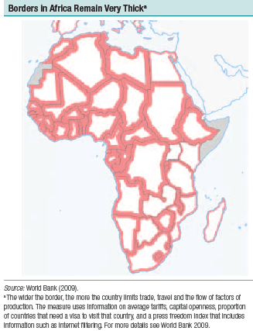
Challenges and Pathways (I)
Africa’s small, fragmented economies and “thick borders”—a legacy of colonial boundaries and underdeveloped infrastructure—make it the most trade-cost-intensive region in the world.
“[....]this regional integration involves some surrender of sovereignty. You have a collection of tin pot dictators, each of whom sees any surrender of sovereignty as undermining their authority. If you are a life president, how do you surrender sovereignty? . The preamble of the AU says something along the lines “we, the heads of state’. It doesn’t say ‘we, the African people’ “.
THANDIKA MKANDAWIRE’S (2014)
Asymetries in natural resource endowments: a cause of conflict. When one country has oil near its border with an oil-less country, the probability of conflict is between three and four times as large as when neither country has oil. In contrast, when the oil is very far from the border, the probability of conflict is not significantly higher than between countries with no oil. Morelli, Rohner and Caselli (2013)

Slide 5
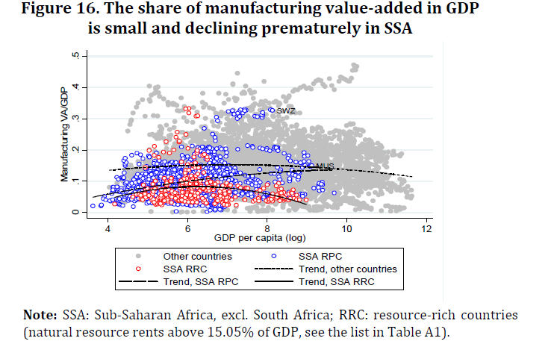
Challenges and Pathways (II)
Cadot et al. (2015)

Slide 6
Architecture Choices Part II

Slide 7
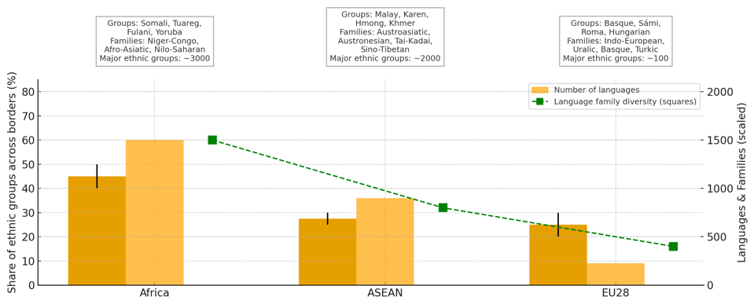
Ethnic & linguistic fragmentation are brakes on market integration
Architecture Choices (I)
Number of countries in parenthesis: ACFTA (54), ASEAN (10), EU (28)
Yellow bars: Number of languages/dialects EU(~300)
Orange bars: Share of cross-border ethnic groups (ranges shown as error bars)
Squares: Number of family diversity
Cross-country evidence:
● Sharing a common language increases bilateral trade by 30-60% (Melitz & Toubal (2014)).
● Ethnic diversity increases conflict in Africa. Over 835 African ethnicities, conflict intensity is 40% higher, the conflict duration 50%-60% higher and the likelihood of conflict 8% higher in homelands of partitioned groups-- i.e. those 28% with at least 10% of their homeland in more than one country--(Michalopoulos and Papaiaonnou 2016).

Slide 8
Deepening regional integration: facing the tariff-reduction “trilemma”...
Architecture Choices (II)
See the unmaking of the CET in EAC
Rauschendorfer and Twum
Melo et al. (2020)

Slide 9
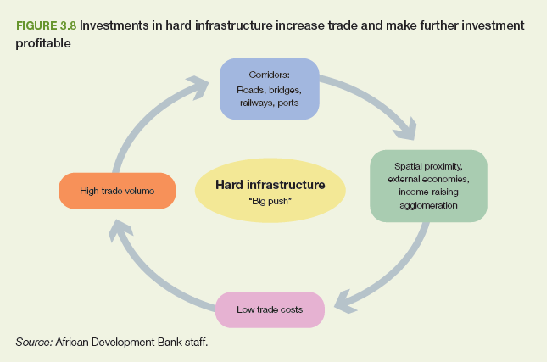
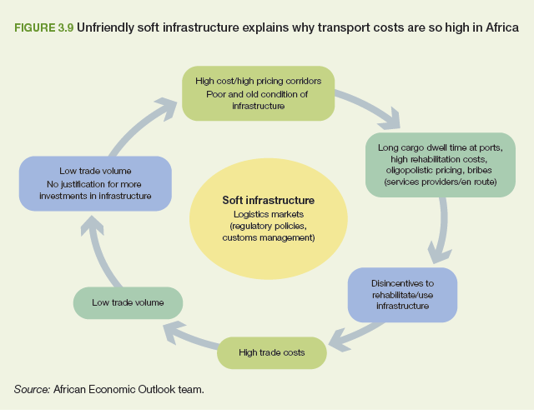
Navigating Virtuous and vicious cycles in high trade costs environment: Regional Public Goods (RPGs) at what scale
Architecture Choices (III)
Curse of population parsity on road density
Africa (pop. Density 55km2; Paved road density ~0.7 km/1,000p. ASEAN:(pop. Density 156km2) paved road density ~4 km/1,000p.
Vicious circle Trade costs due to poorly functioning logistics markets greater barrier to trade than tariffs and NTMs combined. (See slide on prognosis for RPGs in annex)
Virtuous circle : Investment in new hard infrastructure reduces trade costs, improve connections across cities, accelerates urbanization, and encourages market integration
Source: Africa Economic Outlook 2019, chapter 3 “Integration for Africa’s Economic Prosperity”

Slide 10
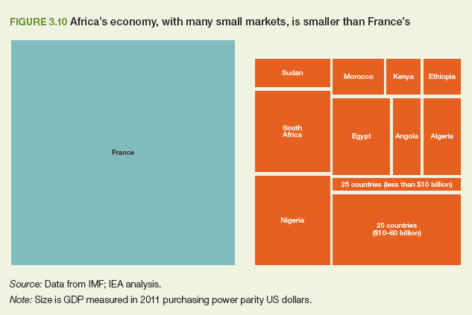
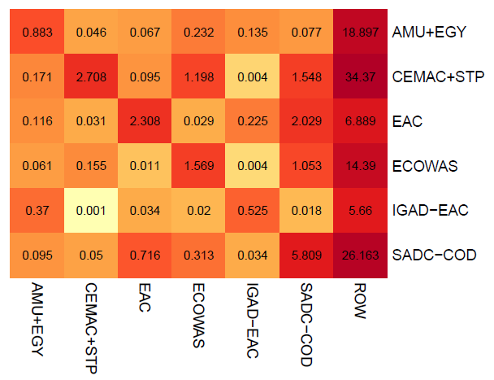
Intra-Africa trade costs are huge! Heatmap of REC exports: Intra-and between-REC as percentage of GDP (Average 2010-2022)
Defragment markets across geographical regions
● Very small markets make trade necessary to realize economies of scale
● Inter-REC trade less than 1% of GDP (except CEMAC and ECOWAS). Average (210-2018)
Notes: REC (Regional Economic Community). RECs are defined to exclude multiple membership.
EAC countries export on average 2.3% of GDP to other EAC members and 6.8% to Rest-of-the-world (ROW) and less than 1% to other RECs !.
Mold (2022) gives corrected estimates showing that intra- African is under-estimated by perhaps 30%-50% because of informal trade and other under-reporting
Yet, East-West and North-South trade is very low
Source: Krantz and D. Beltekian (2025, figure 4)

Slide 11
Deliverables for the AFCFTA Part III

Slide 12
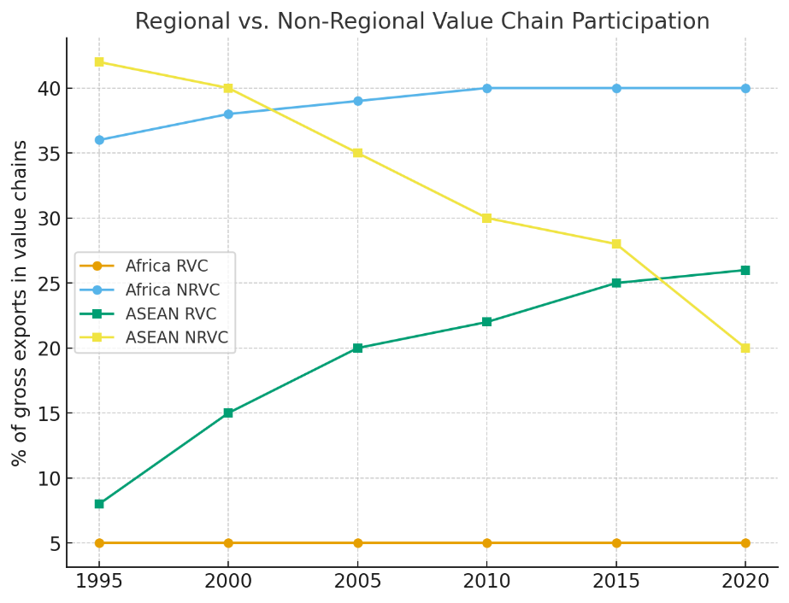
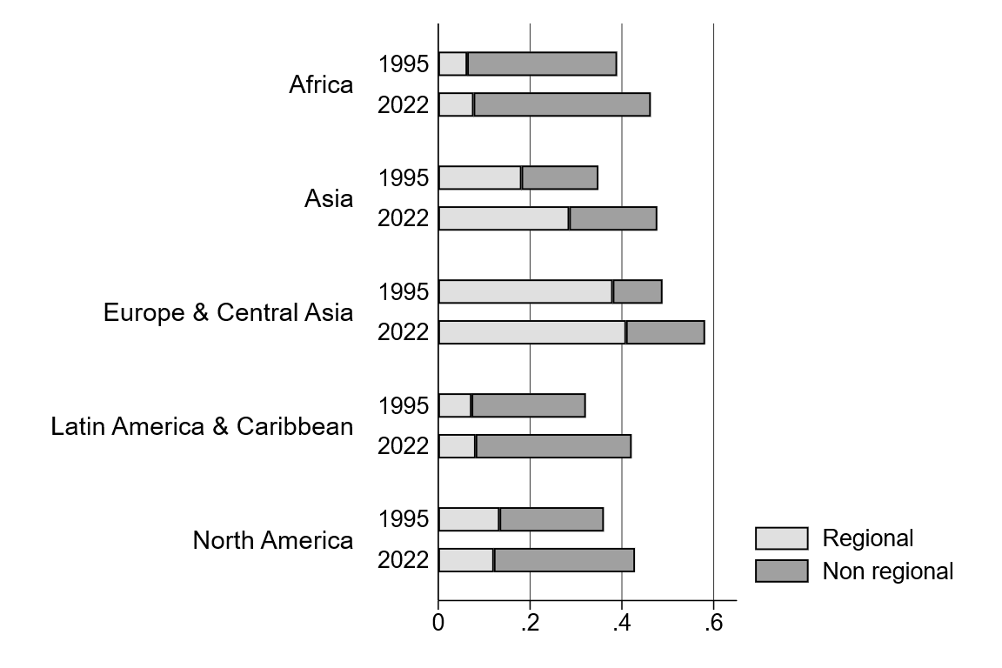
AFCFTA deliverables (I): Contribute towards ‘made in Africa’
Over 1995-2022, Asia region (here excluding China and India) turned towards regional supply chains (“made in Asia”) while Africa’s supply chains grew faster with countries outside the region (“made elsewhere”).
“Made in the world” is coming to an end. Can AfCFTA help move towards a “made in Africa”? For this to happen supply chains will have to develop with partners within the region (i.e. African trade partners). Happened in ASEAN but has not yet started in Africa.
To reverse trend and move to ‘made in Africa’, reductions in trade barriers to intra-African trade will have to go beyond reducing tariffs to include reduction in NTBs, less restrictive Rules of Origin for AfCFTA trade and more efficient customs
Source: Melo and Solleder (2025)

Slide 13
(as of 2022 yes is on tariff lines with low preference margins and low R-index. i.e. Low restrictiveness)
AFCFTA deliverables (II) : PSR agreed on products with low preference margins
Source: Gourdon et al. (2022, table 8)

Slide 14
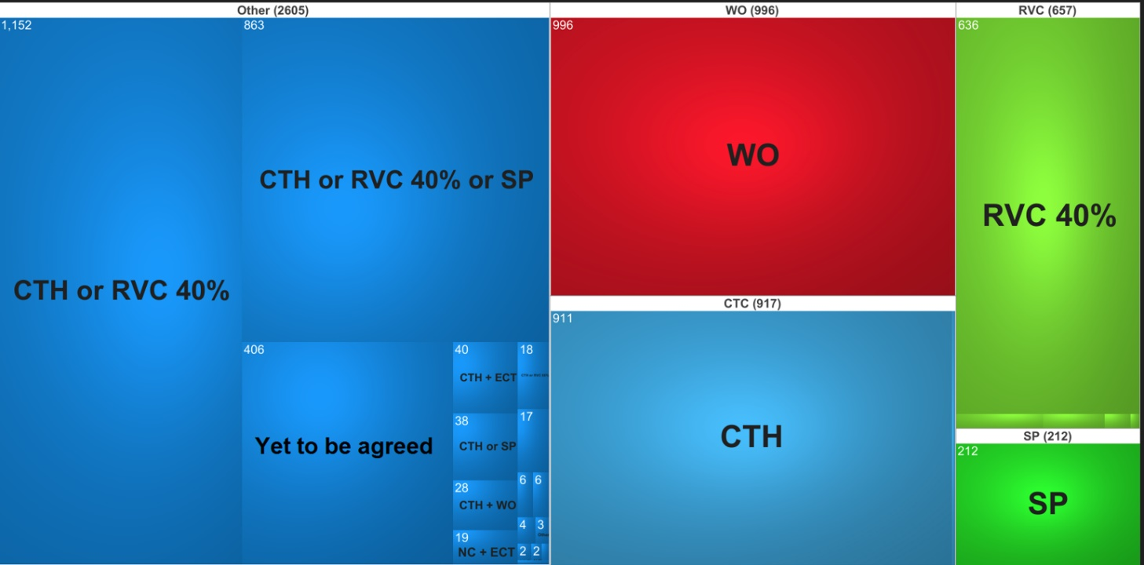
AFCFTA deliverables (III) : Failure at delivering user-friendly PSRs
State of negotiations in April 2025
After 6 years of negotiations, in March 2025 7% of TLs (5600 tariff lines) are yet to be agreed Among agreed, 17% Wholly Obtained (WO), 3.7% Specific Process (SP). Choice for 37% of TLs
RoO are more restrictive in highly protected sectors. Gourdon et al. (2023) simulation exercise shows that a radical simplification reform leading to the adoption of flexible PSRs providing alternative choices to prove origin would have increased global trade on average by between 2.7 and 4% over the sample period for a sample of 128 reciprocal RTAs

Slide 15
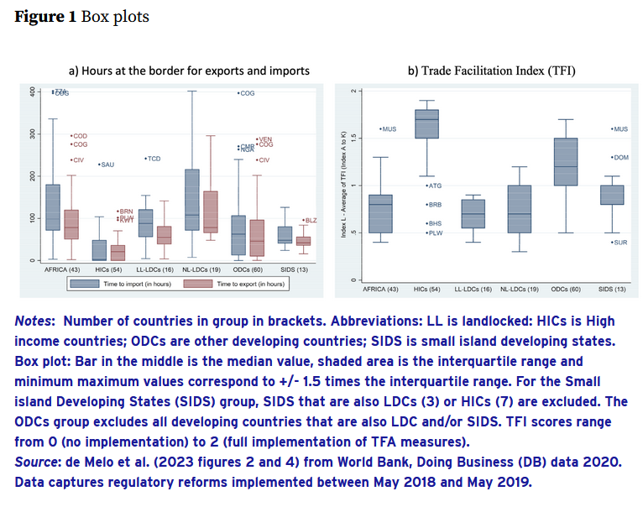
AFCFTA deliverables (IV): Take the Trade Facilitation Agreement seriously
Sample is split into 6 non-overlapping groups
Hours at the border for imports and exports are higher for African countries.
Scores on the trade facilitation index are lower for African countries.
Hours (costs to clear customs) are regressed on TFIs to get predicted time at customs.

Slide 16
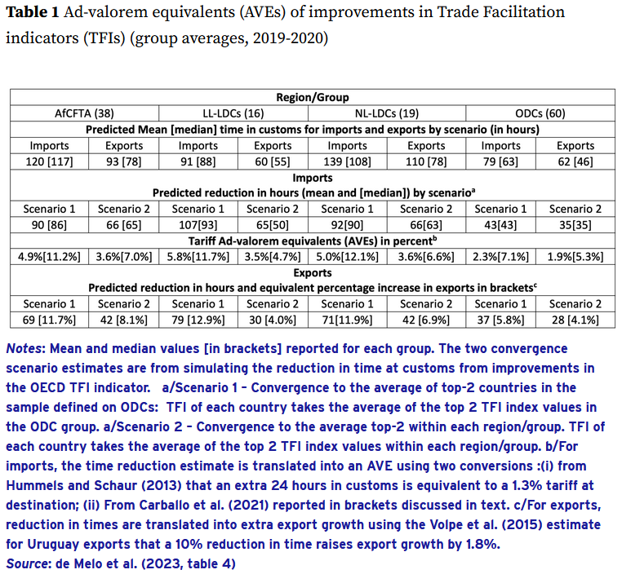
AFCFTA deliverables (V): Take the Trade Facilitation Agreement seriously
Realistic (in the sense of achievable) improvements in customs clearance and other formalities under serious implementation of TFA would be equivalent to:
5%-10% reduction in tariff at destination
8%-11% increase in exports

Slide 17
Takeaways
Africa most trade-cost-intensive region of the world.
Trade necessary to break the curse of small markets is hampered by sharp ethnic and linguistic fractionalization and asymmetries in natural resource endowments that cause conflict
Africa’s premature de-industrialization at low per capita income levels, exacerbates challenge to secure jobs for a rapidly growing workforce
Tariff-reduction under ACFTA faces a trilemma:
Solidarity (TFTA, ACFTA) requires SDT
shallow integration (tariff elimination only) possible in large groups (COMESA, ECOWAS)
Deep integration (beyond tariff elimination) possible in small groups (EAC);
Difficult choices to make on soft and hard infrastructure to break vicious circles and start virtuous cycles
Huge market fragmentation for inter-REC trade (East-West; North-South) now around 1% of GDP
Feasible AFCFTA deliverables
Rules of origin that are user-friendly rather than business-owned
Apply Trade Facilitation Agreement (TFA) seriously

Slide 18
References
Africa Development Bank (2019), Africa Economic Outlook, chp. 3 “Integration for Africa’s prosperity”
Andrews, M., L. Pritchett, and M. Woolcock. 2017. Building State Capability: Evidence, Analysis, Action. Oxford, UK: Oxford University Press.
Cadot, O., J. de Melo, P. Plane, L. Wagner, M. Woldemichael (2016) “L’Afrique peut-elle s’industrialiser sans usines ?” Revue d’Economie du développement, 2, 19-50
Gourdon, D. Kniahin, J. de Melo and M. Mimouni (2021) “Closing in on Harmonizing Rules of Origin for AFCFTA: Anatomy of Reconciliations and Remaining Challenges”, ITC WP series .
Gourdon, J., Gourdon, K., and J. de Melo (2023) «A More Systematic Exploration of the Trade Effect of Product-Specific Rules of Origin”, World Trade Review, 22,421-35.
Krantz and D. Beltekian (2025) “Africa's Regional and Global Integration”, SSRN, https://papers.ssrn.com/sol3/papers.cfm?abstract_id=4929189.
Mangeni, and Mold (2024) Borderless Africa: A sceptics guide to the Continental Free Trade Area,
Melitz, J. and F. Toubal (2014) “Native language, spoken language, translation and Trade”, Journal of International Economics, 93(2) https://www.sciencedirect.com/science/article/abs/pii/S0022199614000543
Melo, J. de and Yvonne Tsikata (2015) “Regional Integration in Africa: Challenges and Prospects”, UNU Wider https://www.wider.unu.edu/publication/regional-integration-africa-0
Melo, J. de, Zakaria Sorgho and Laurent Wagner) “Reducing Wait Times at Customs to Boost Trade: How Implementing the Trade Facilitation Agreement (TFA) can Expand Trade among AfCFTA countries?”, Journal of African Economies. https://doi.org/10.1093/jae/ejae008
Melo, J. de and JM. Solleder (2025) “How can the Africa Continental Free Trade Area (AfCFTA) help develop regional value chains across Africa? An exploration.”, Review of World Economics, 160(4), https://doi.org/10.1007/s10290-024-00574-0
Melo, J. de (2025) “Essays on Africa’s integration: Challenges and Prospects for markets and Regional Public Goods”, https://ferdi.fr/en/publications/d4de0447-1e04-41bf-8387-55c0d1ebf412
Michalopoulos and Papaioannou (2016) “The Long-Run Effects of the Scramble for Africa” American Economic Review, 106(7)
Mold, A. (2022) “The economic significance of intra-African trade: getting the narrative right”, Brookings
Morelli, Rohner and Caselli (2013) “Asymetric oil: fuel for conflict”, VOXeu, https://cepr.org/voxeu/columns/asymmetric-oil-fuel-conflict
Rauschendorfer and Twum (2021) “Unmaking of a Customs Union: Regional (Dis)Integration in the East African Community”, World Trade Review
Sytsma, T. (2021) “Rules of Origin and Trade Preference Utilization among LDCs”, https://www.freit.org/WorkingPapers/Papers/TradePolicyGeneral/FREIT1749.pdf

Slide 19
EXTRA SLIDES

Slide 20
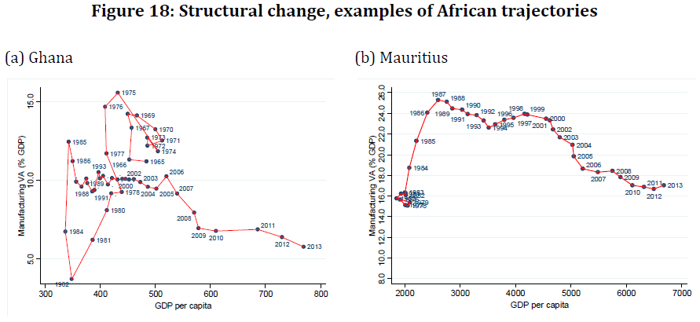
Trajectories of premature deindustrialization
More trajectories in Cadot et al. (2015)

Slide 21
Reminder: Monitor the difficulties at implementing a Customs union
Tally of all Stay of Applications (SOAs) collected from the EAC gazette
Large countries deviated from the CET in upward direction
Rwanda deviated in the lower direction
→In CUs high CETs are imposed by large members on small members (e.g. Liberia and Sierra Leone in ECOWAS)
CGE Simulation-based estimates of gains from completing AFCFTA should be taken with caution
Source: Rauschendorfer and Twum (2021)

Slide 22
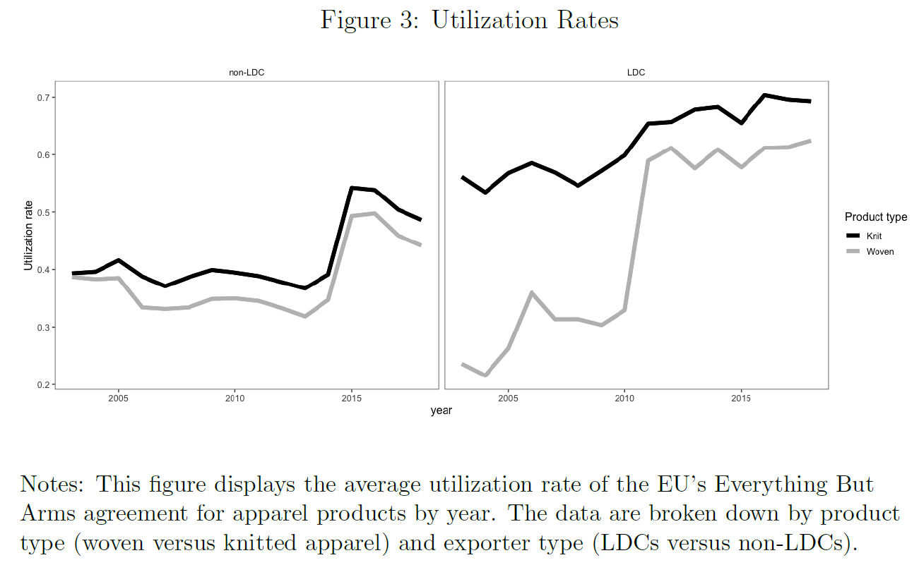
Preference Utilization Rates and PSRs (for the skeptics)
Passage to single transformation rule for EBA (i.e. for LDCs) in January 2011 (vertical bar)
⟹ Controlling for other factors, EBA PUR up by 50% at pre-baseline level with PUR increase higher for products with higher non-preferential tariff rates
Source: Sytsma, 2021

Slide 23
Take seriously the unecessary complexity of Rules of Origin
REMINDER: Excerpt from the conclusion of an evaluation of EU and US PTAs published in the World Trade Review (2006) where the authors mention their hope that a report they had just submitted to the EC commission would lead to such simplification…..
...but not much has changed. See for example the presentation by Marti at a WTO webinar in April 2021 on low utilization of preferences by LDCs in non-reciprocal PTAs https://www.wto.org/english/tratop_e/roi_e/preference_utilization_190521_e.htm

