Slide 1
Integrity and Trade Facilitation through performance measurement in the Liberia Customs administration
12-13 June 2014, Clermont Ferrand
Presented by
Giuseppe Di Capua and Patricia Revesz

Slide 2
Summary
Introduction
Background
Approach to Performance Measurement in Liberia
Description of the Performance Measurement system
Deployment Strategy for the Performance Measurement system
Initial results
Conclusions

Slide 3
Introduction
Fighting corruption is key to the success of reforms
Fighting corruption in Customs and Tax administrations remain a challenge:
Widespread corruption => high risk of failure
Hidden phenomenon
Limitation of traditional approaches
Even with political will => asymmetry of information
Performance measurement using data contained in automated Customs clearance system
WCO/UNCTAD cooperation

Slide 4
Background
Why quantification in Customs and Tax administrations?
Nature of its work calls for quantification
Different perspective from New Public Management => empowers Customs and Tax administrations to engage in a dialogue with supervisory authority, staff and stakeholders
Where other programmes have failed, performance measurement has given good results in monitoring Customs activities (community and individual through contracting) and detecing bad practices

Slide 5
Background
Cameroon Customs: a pioneer with regard to performance measurement and contracting
Using data contained in ASYCUDA ++ allowed this administration to:
Increase revenue – additional USD 16.5 million
Increase revenue from disputed claims (17% and 322%)
Enhance trade facilitation : almost 90% of declarations assessed the day they were registered
Reduced processing times – 2h37 minutes to 24 minutes (DPV) and 4h22 minutes to 1h14 minutes (DPI)
Less rerouting but more efficiency – 5% to 6% - fine rates from 18% to 50% (DPI) – 0,58% to 0, 56% but adjustment rates 5%-62% (DPV)

Slide 6
Background
Togo and Liberia Customs wished to embark on a similar project
Experimentation not reproduction
Adapt to the local context and find modalities that are suitable
Allow time to understand the local context

Slide 7
Approach to Performance Measurement in Liberia (1)
Liberia context
Post-conflict country →scarse and poor capacities
High staff turnover → impact also on Project Team
Senior management → committed, low power distance
WCO/UNCTAD Team
Mix of competences (Customs, IT, TC management)
Open mindness and flexibility
Cameroon and Togo experience

Slide 8
Approach to Performance Measurement(PM) in Liberia (2)
Operational agility in Customs
Ability to quickly and effectively undertake significant changes
Need for instruments presenting reality as close as possible
Factors for success in developing PM applications
Continued senior management commitment,
Minimized time and effort required.
Simplified application of the process.
Easily recognizable benefits of performance measurement.
Software agility
Evolving and expanding project scope
Quick development cycles

Slide 9
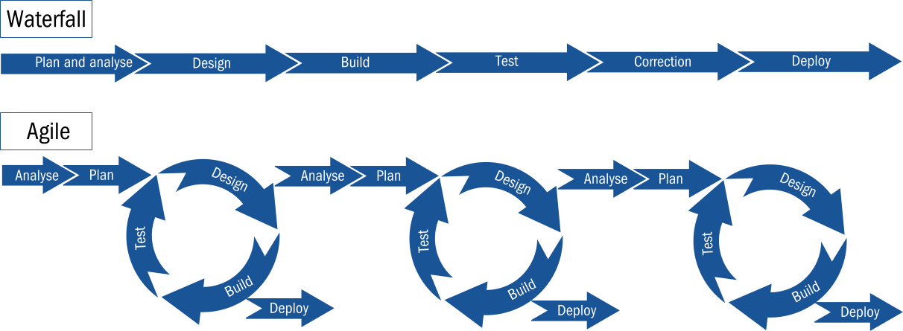
Approach to Performance Measurement(PM) in Liberia (3)
(adapted from Gupta A. 2012)

Slide 10
Description of the Performance Measurement system
Web application
Statistical database with a visual querying facility
Five categories of indicators
Activity,
Delay,
Monitoring and control of practices,
Revenue and enforcement,
System integrity.
Examples:
A-01: Registered and paid declarations by office code
R-07: Customs activities for enforcement

Slide 11
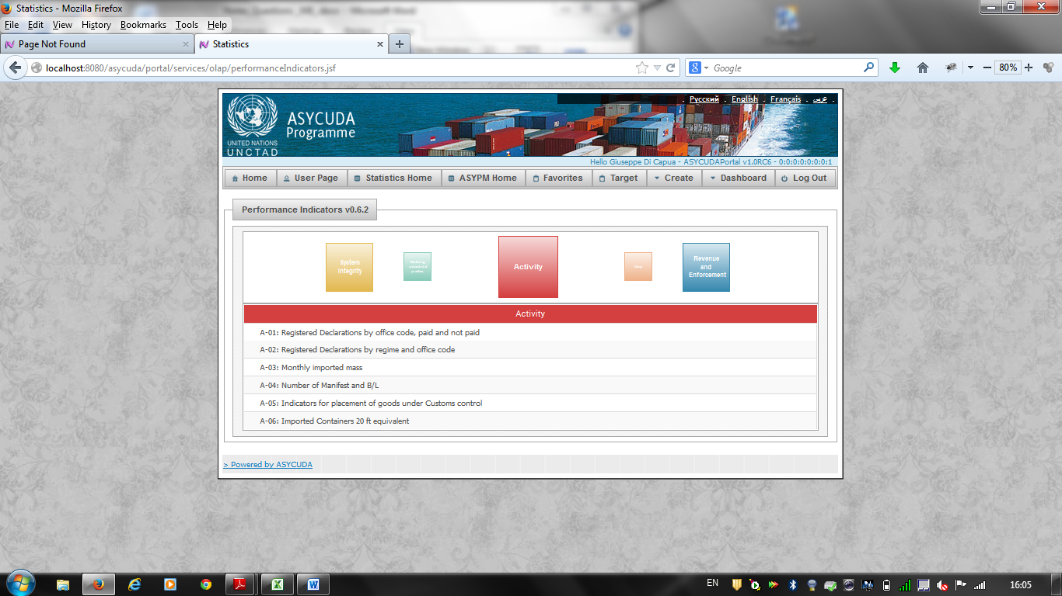

Slide 12
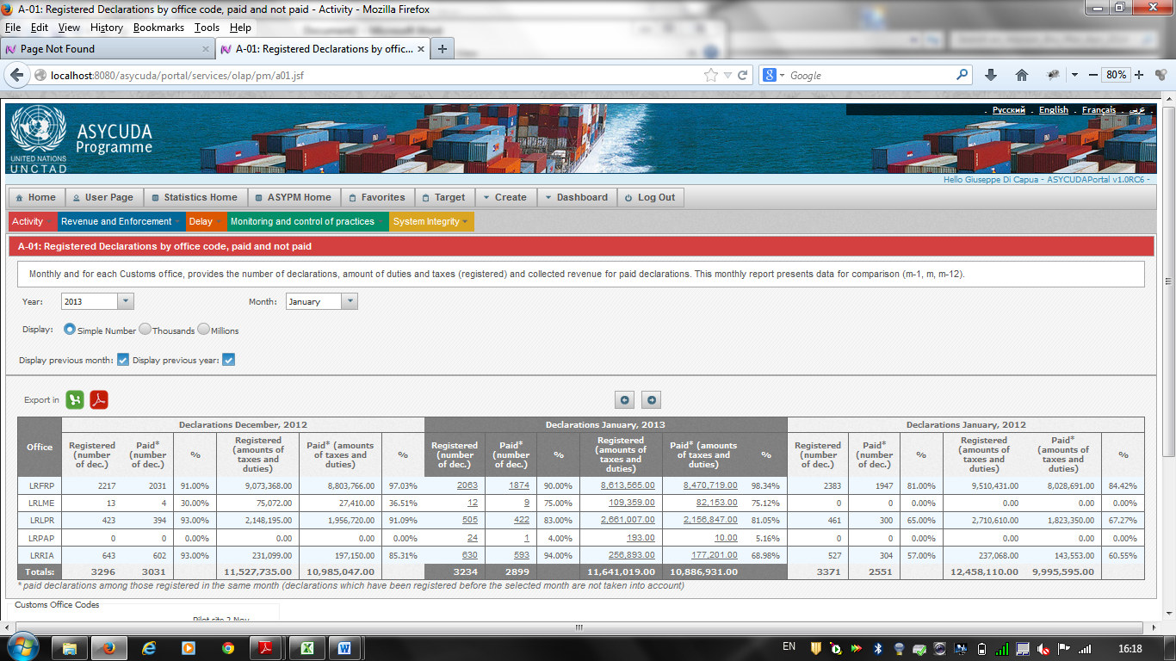

Slide 13
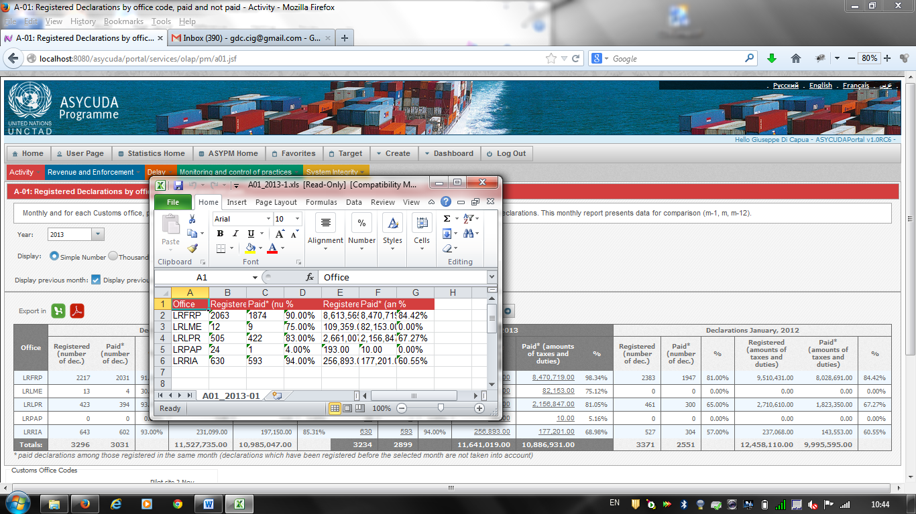

Slide 14
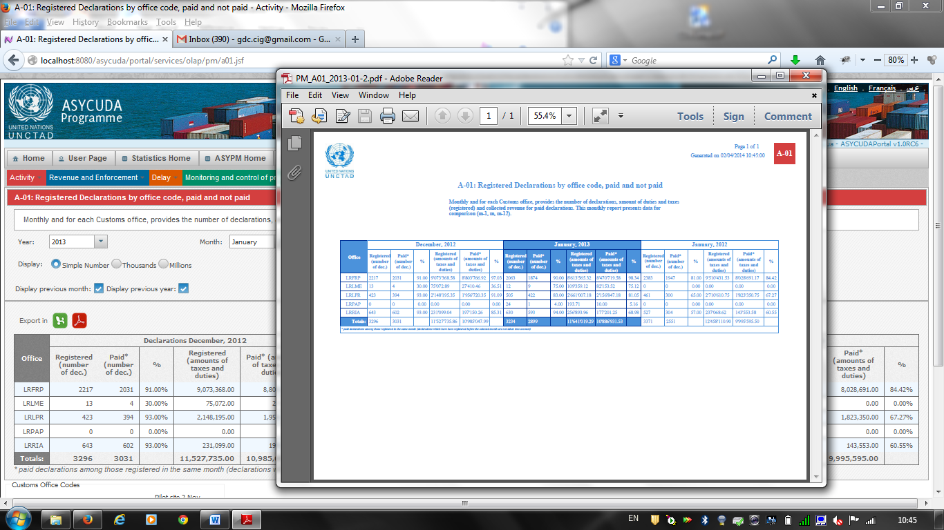

Slide 17
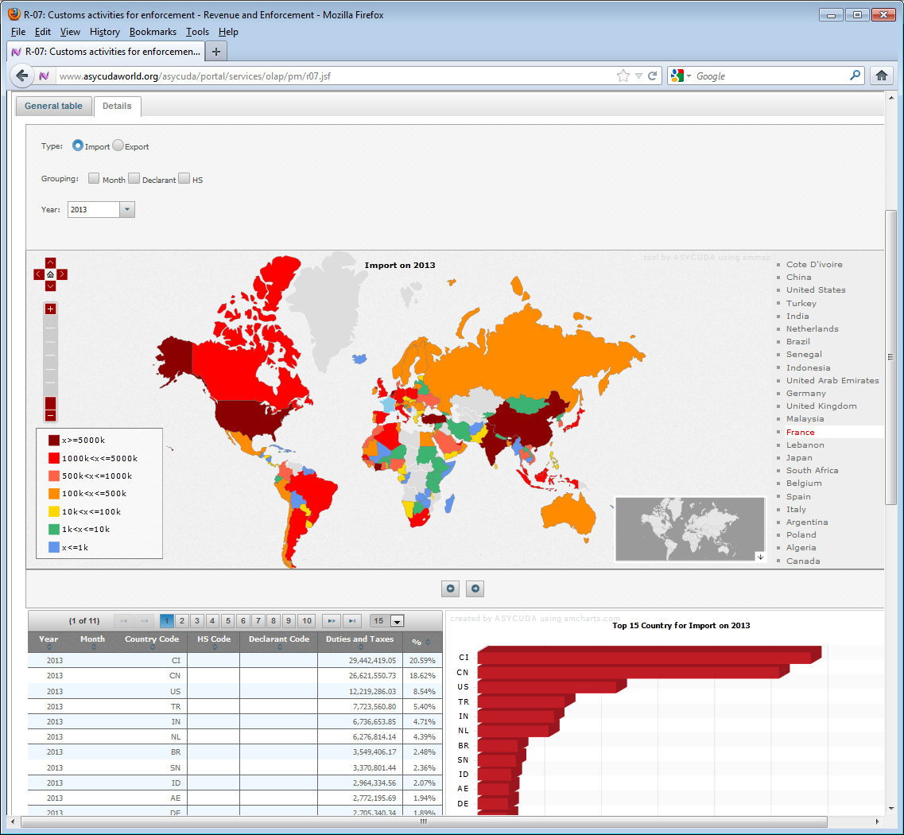

Slide 18
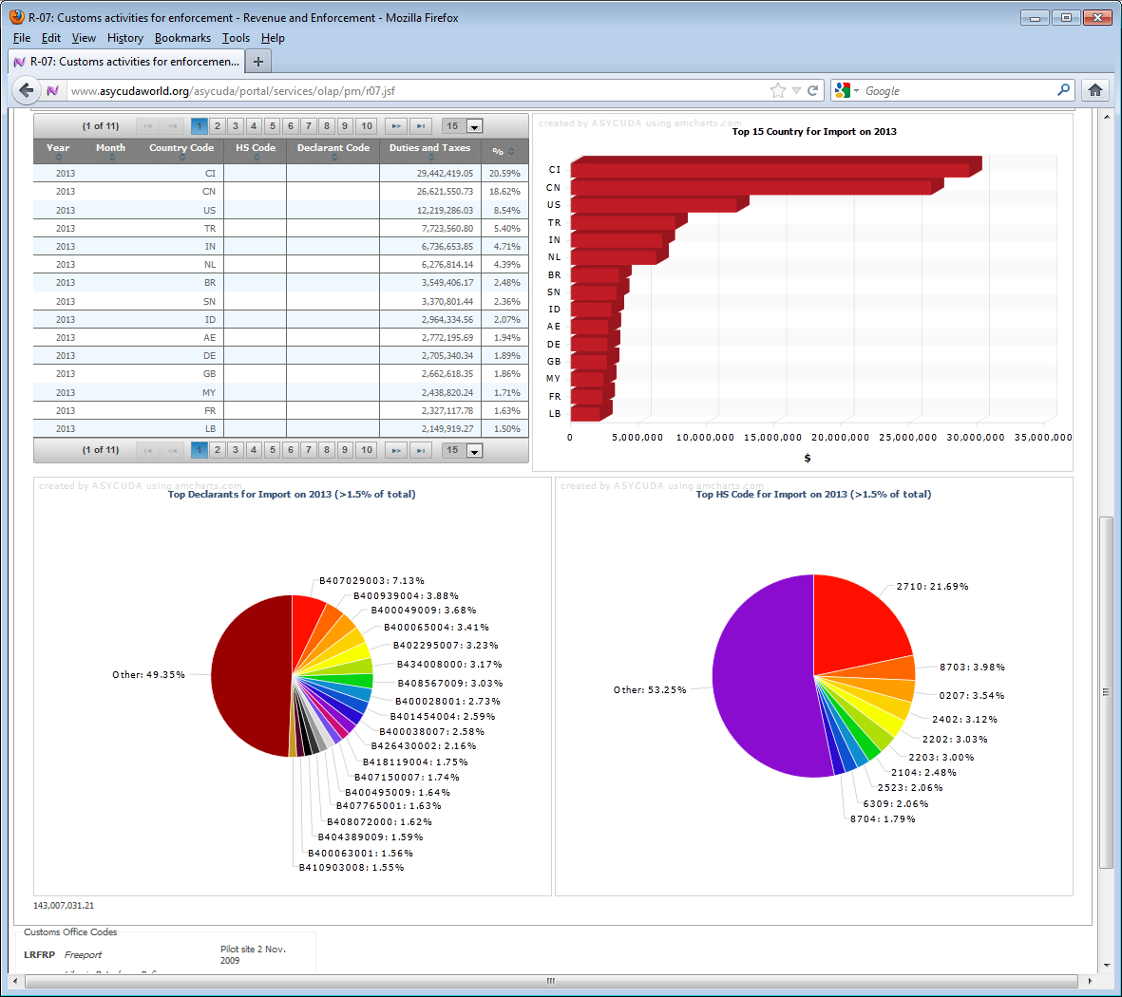

Slide 19
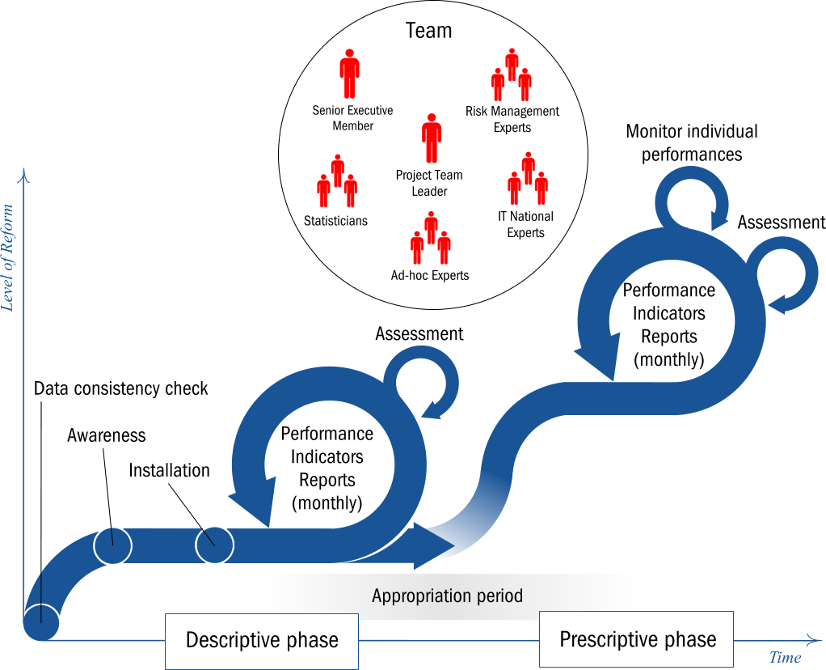
Deployment Strategy for the Performance Measurement system (1)

Slide 20
Deployment Strategy for the Performance Measurement system (2)
Descriptive phase (12-24 months)
create awareness,
strengthen senior management commitment,
understand the realities of the administration
through functional experts visits of the main Customs office,
interviews with operational staff, and
meetings with stakeholders
Interventions:
data consistency check
awareness mission
installation and data mining mission

Slide 21
Initial results
Situation in Liberia Customs
93%declarations through physical inspection
Systematic manual re-assignment of declarations
Early days but impacted already on
Senior management – reduced asymmetry of information
Staff – aware of being monitored
Private sector – improved dialogue (APMT, brokers)

Slide 22
Initial results at Freeport
Re-assignment
 | February | March | April
Assessors | 717 | 335 | 311
Examiners | 478 | 212 | 114

Slide 23
Initial results at Freeport
% of duties and taxes recovered thanks to the new measures
Nov 2013: first mission; Jan 2014 installation; March 2014 launch

Slide 24
Conclusions
Performance measurement has contributed to:
Developing a new professional culture
Establishing a new type of relationship between senior management and frontline officers
Giving a certain degree of autonomy to staff
Increasing accountability of all parties
Easing the decision-making process
ABOVE ALL INTEGRITY IS EMBEDDED IN THE REFORM

